Slide 1
Dynamic HTML: Event Model
Outline
1 Introduction
2 Event onclick
3 Event onload
4 Error Handling with onerror
5 Tracking the Mouse with Event onmousemove
6 Rollovers with onmouseover and onmouseout
7 Form Processing with onfocus and onblur
8 More Form Processing with onsubmit and onreset
9 Event Bubbling
10 More DHTML Events
11 Web Resources

Slide 2
Objectives
In this lesson, you will learn:
To understand the notion of events, event handlers and event bubbling.
To be able to create event handlers that respond to mouse and keyboard events.
To be able to use the event object to be made aware of and, ultimately, respond to user actions.
To understand how to recognize and respond to the most popular events.

Slide 3
1 Introduction
Event model
Scripts can respond to user
Content becomes more dynamic
Interfaces become more intuitive

Slide 4
2 Event onclick
onClick
Invoked when user clicks the mouse on a specific item

Slide 5
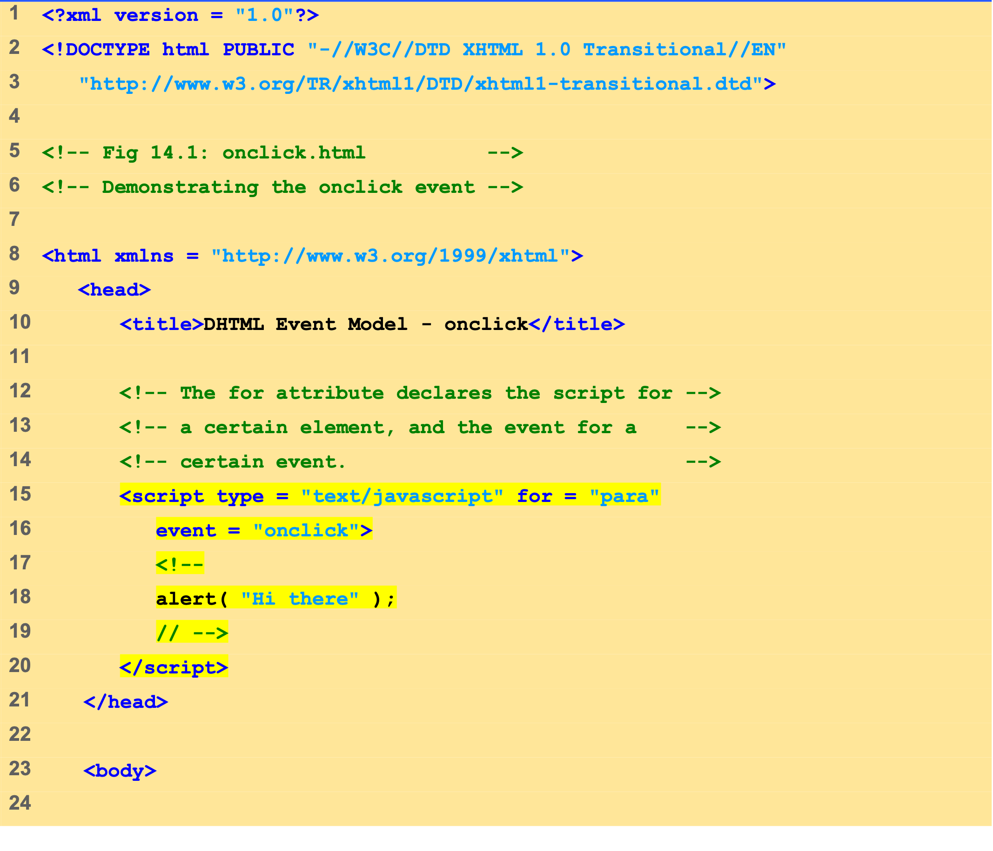
onclick.html (1 of 2)

Slide 6
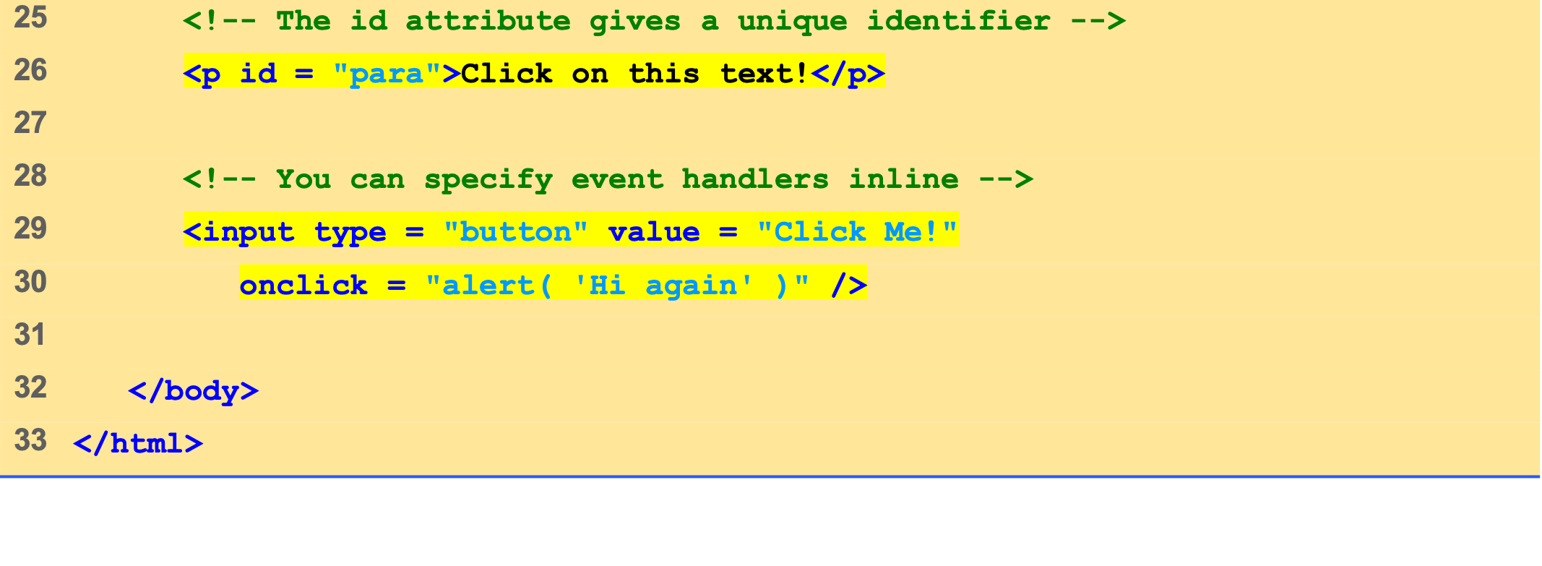
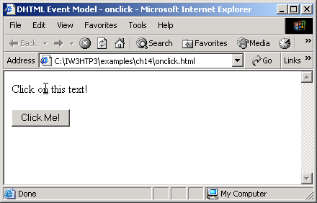
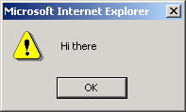
onclick.html (2 of 2)

Slide 7
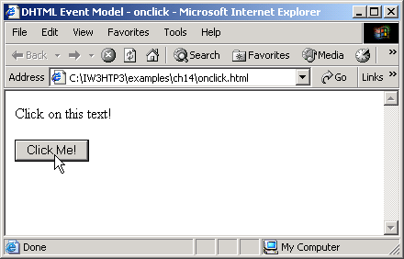
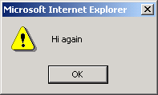

Slide 8
3 Event onload
onload event
Fires when an element finishes loading
Used in the body element
Initiates a script after the page loads into the client

Slide 9
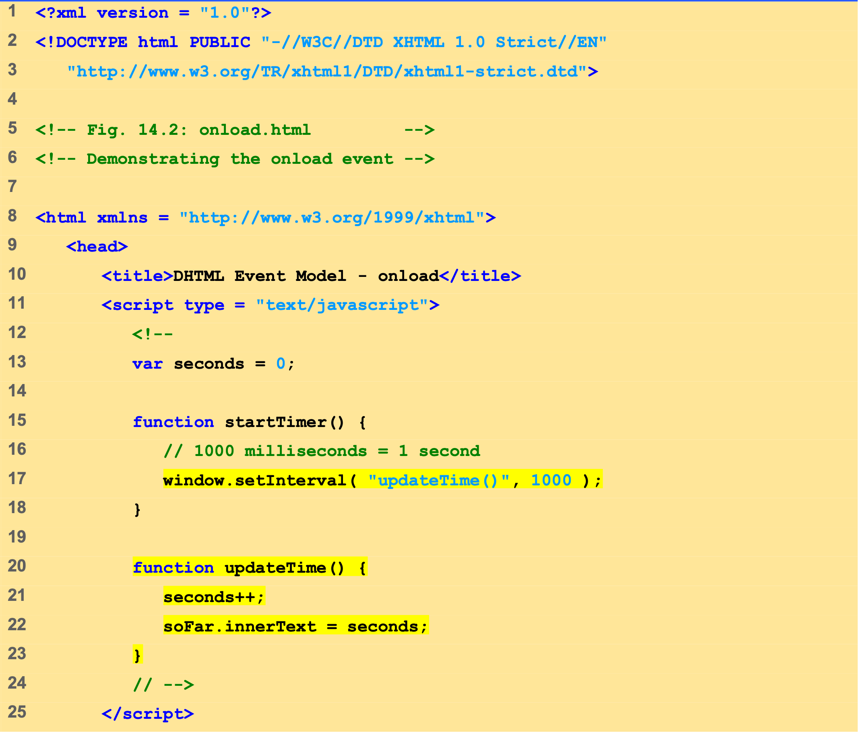
onload.html (1 of 2)

Slide 10
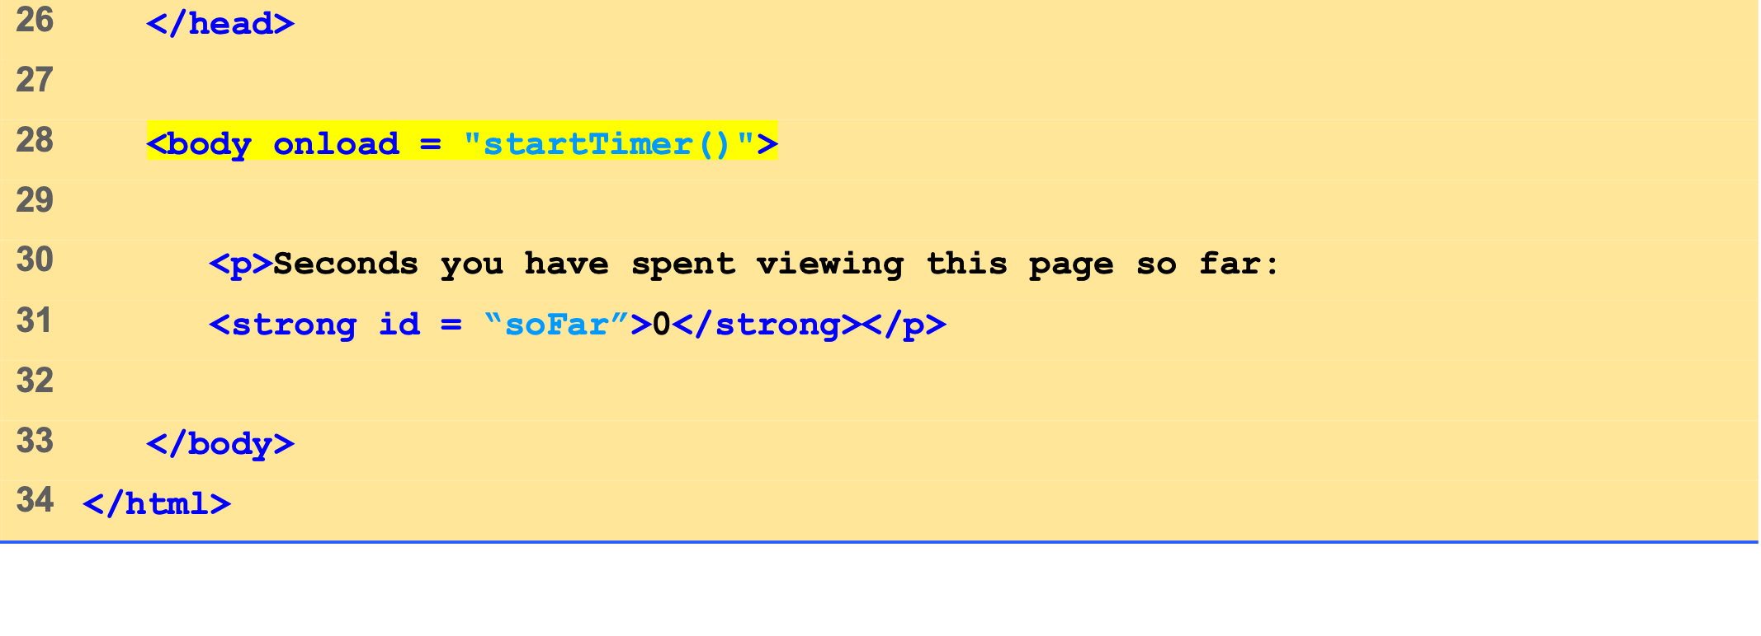
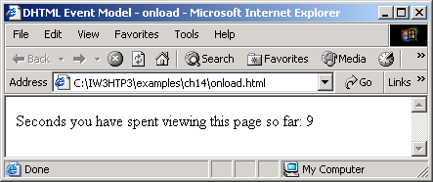
onload.html (2 of 2)

Slide 11
4 Error Handling with onerror
onerror event
Execute specialized error-handling code

Slide 12
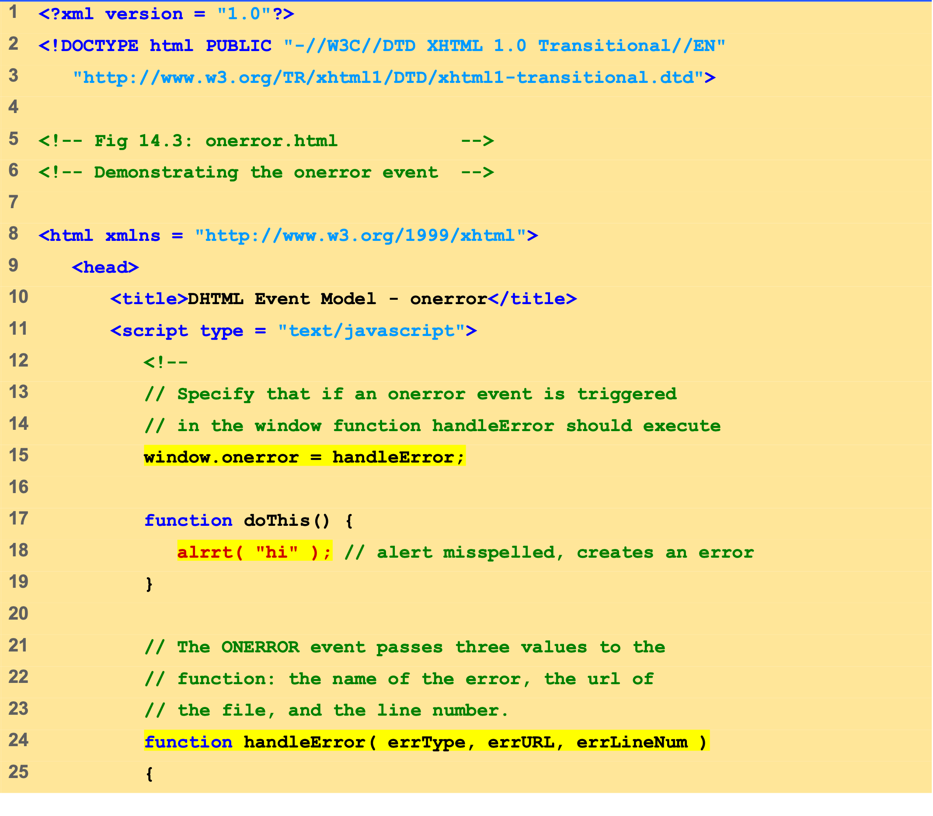
onerror.html (1 of 2)

Slide 13
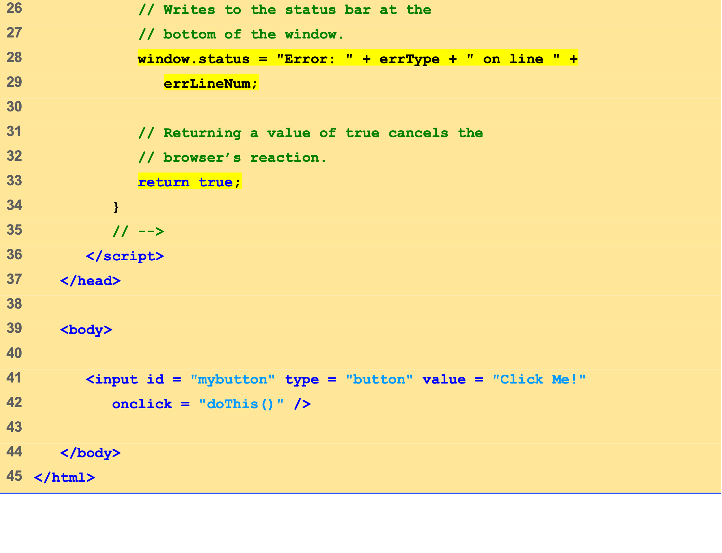
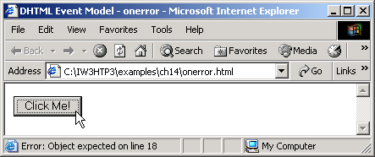
onerror.html (2 of 2)

Slide 14
5 Tracking the Mouse with Event onmousemove
onmousemove
Fires repeatedly when the user moves the mouse over the Web page
Gives position of the mouse

Slide 15
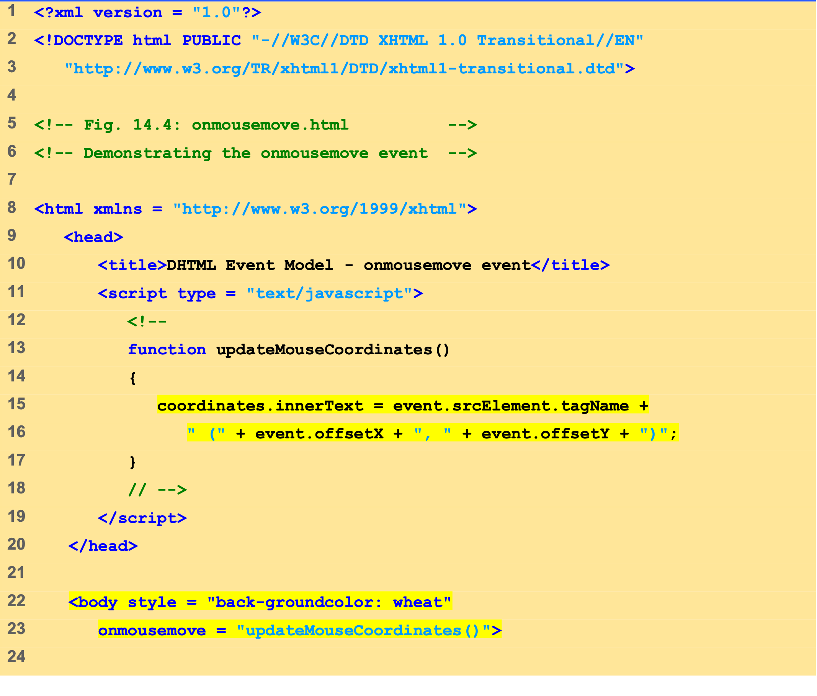
onmousemove.html (1 of 2)

Slide 16
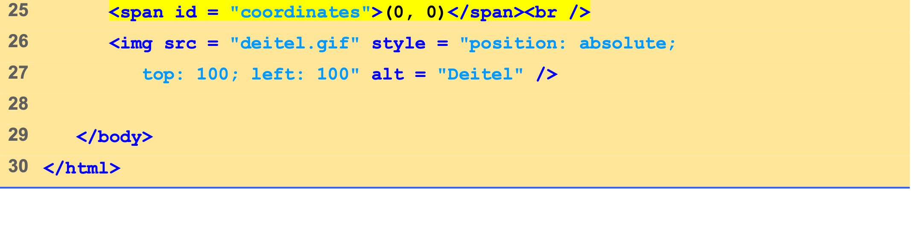
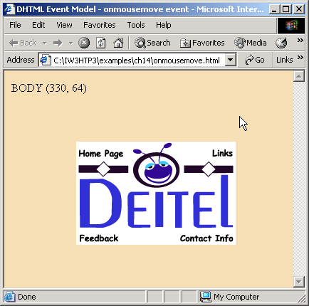

onmousemove.html (2 of 2)

Slide 17
6 Rollovers with onmouseover and onmouseout
Two more events fired by mouse movements
onmouseover
Mouse cursor moves over element
Onmouseout
Mouse cursor leaves element

Slide 18
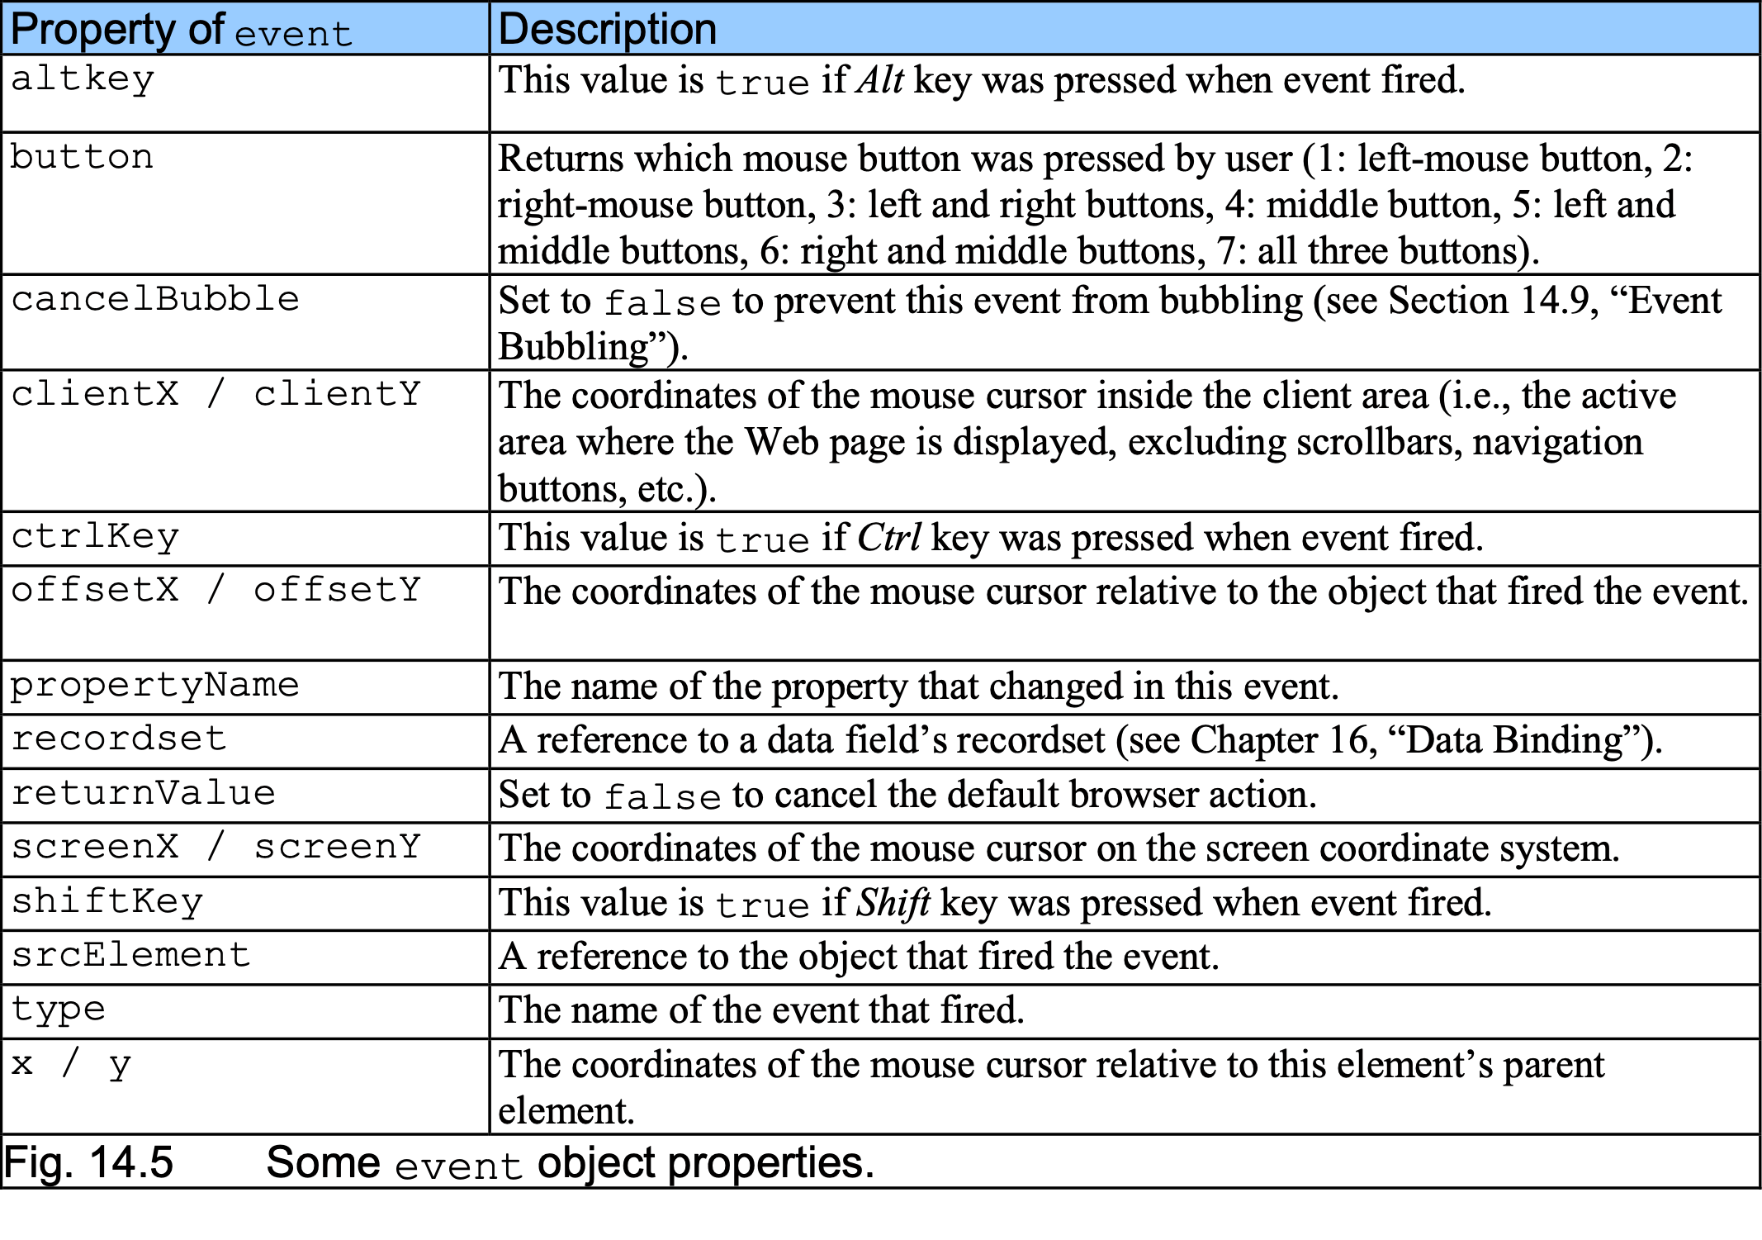
6 Rollovers with onmouseover and onmouseout

Slide 19
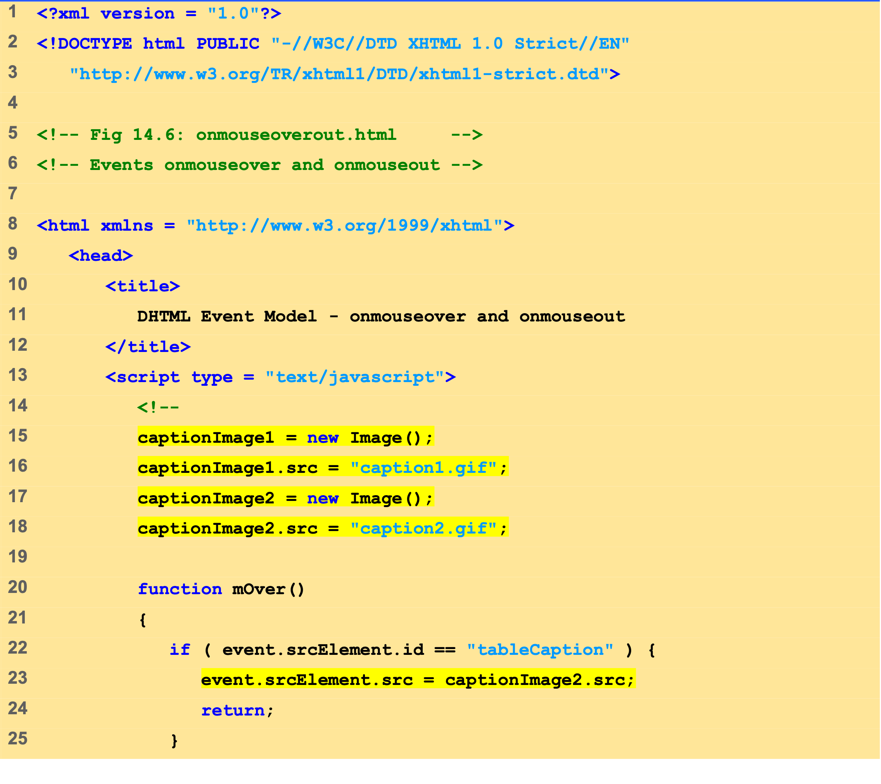
onmouseoverout .html (1 of 4)

Slide 20
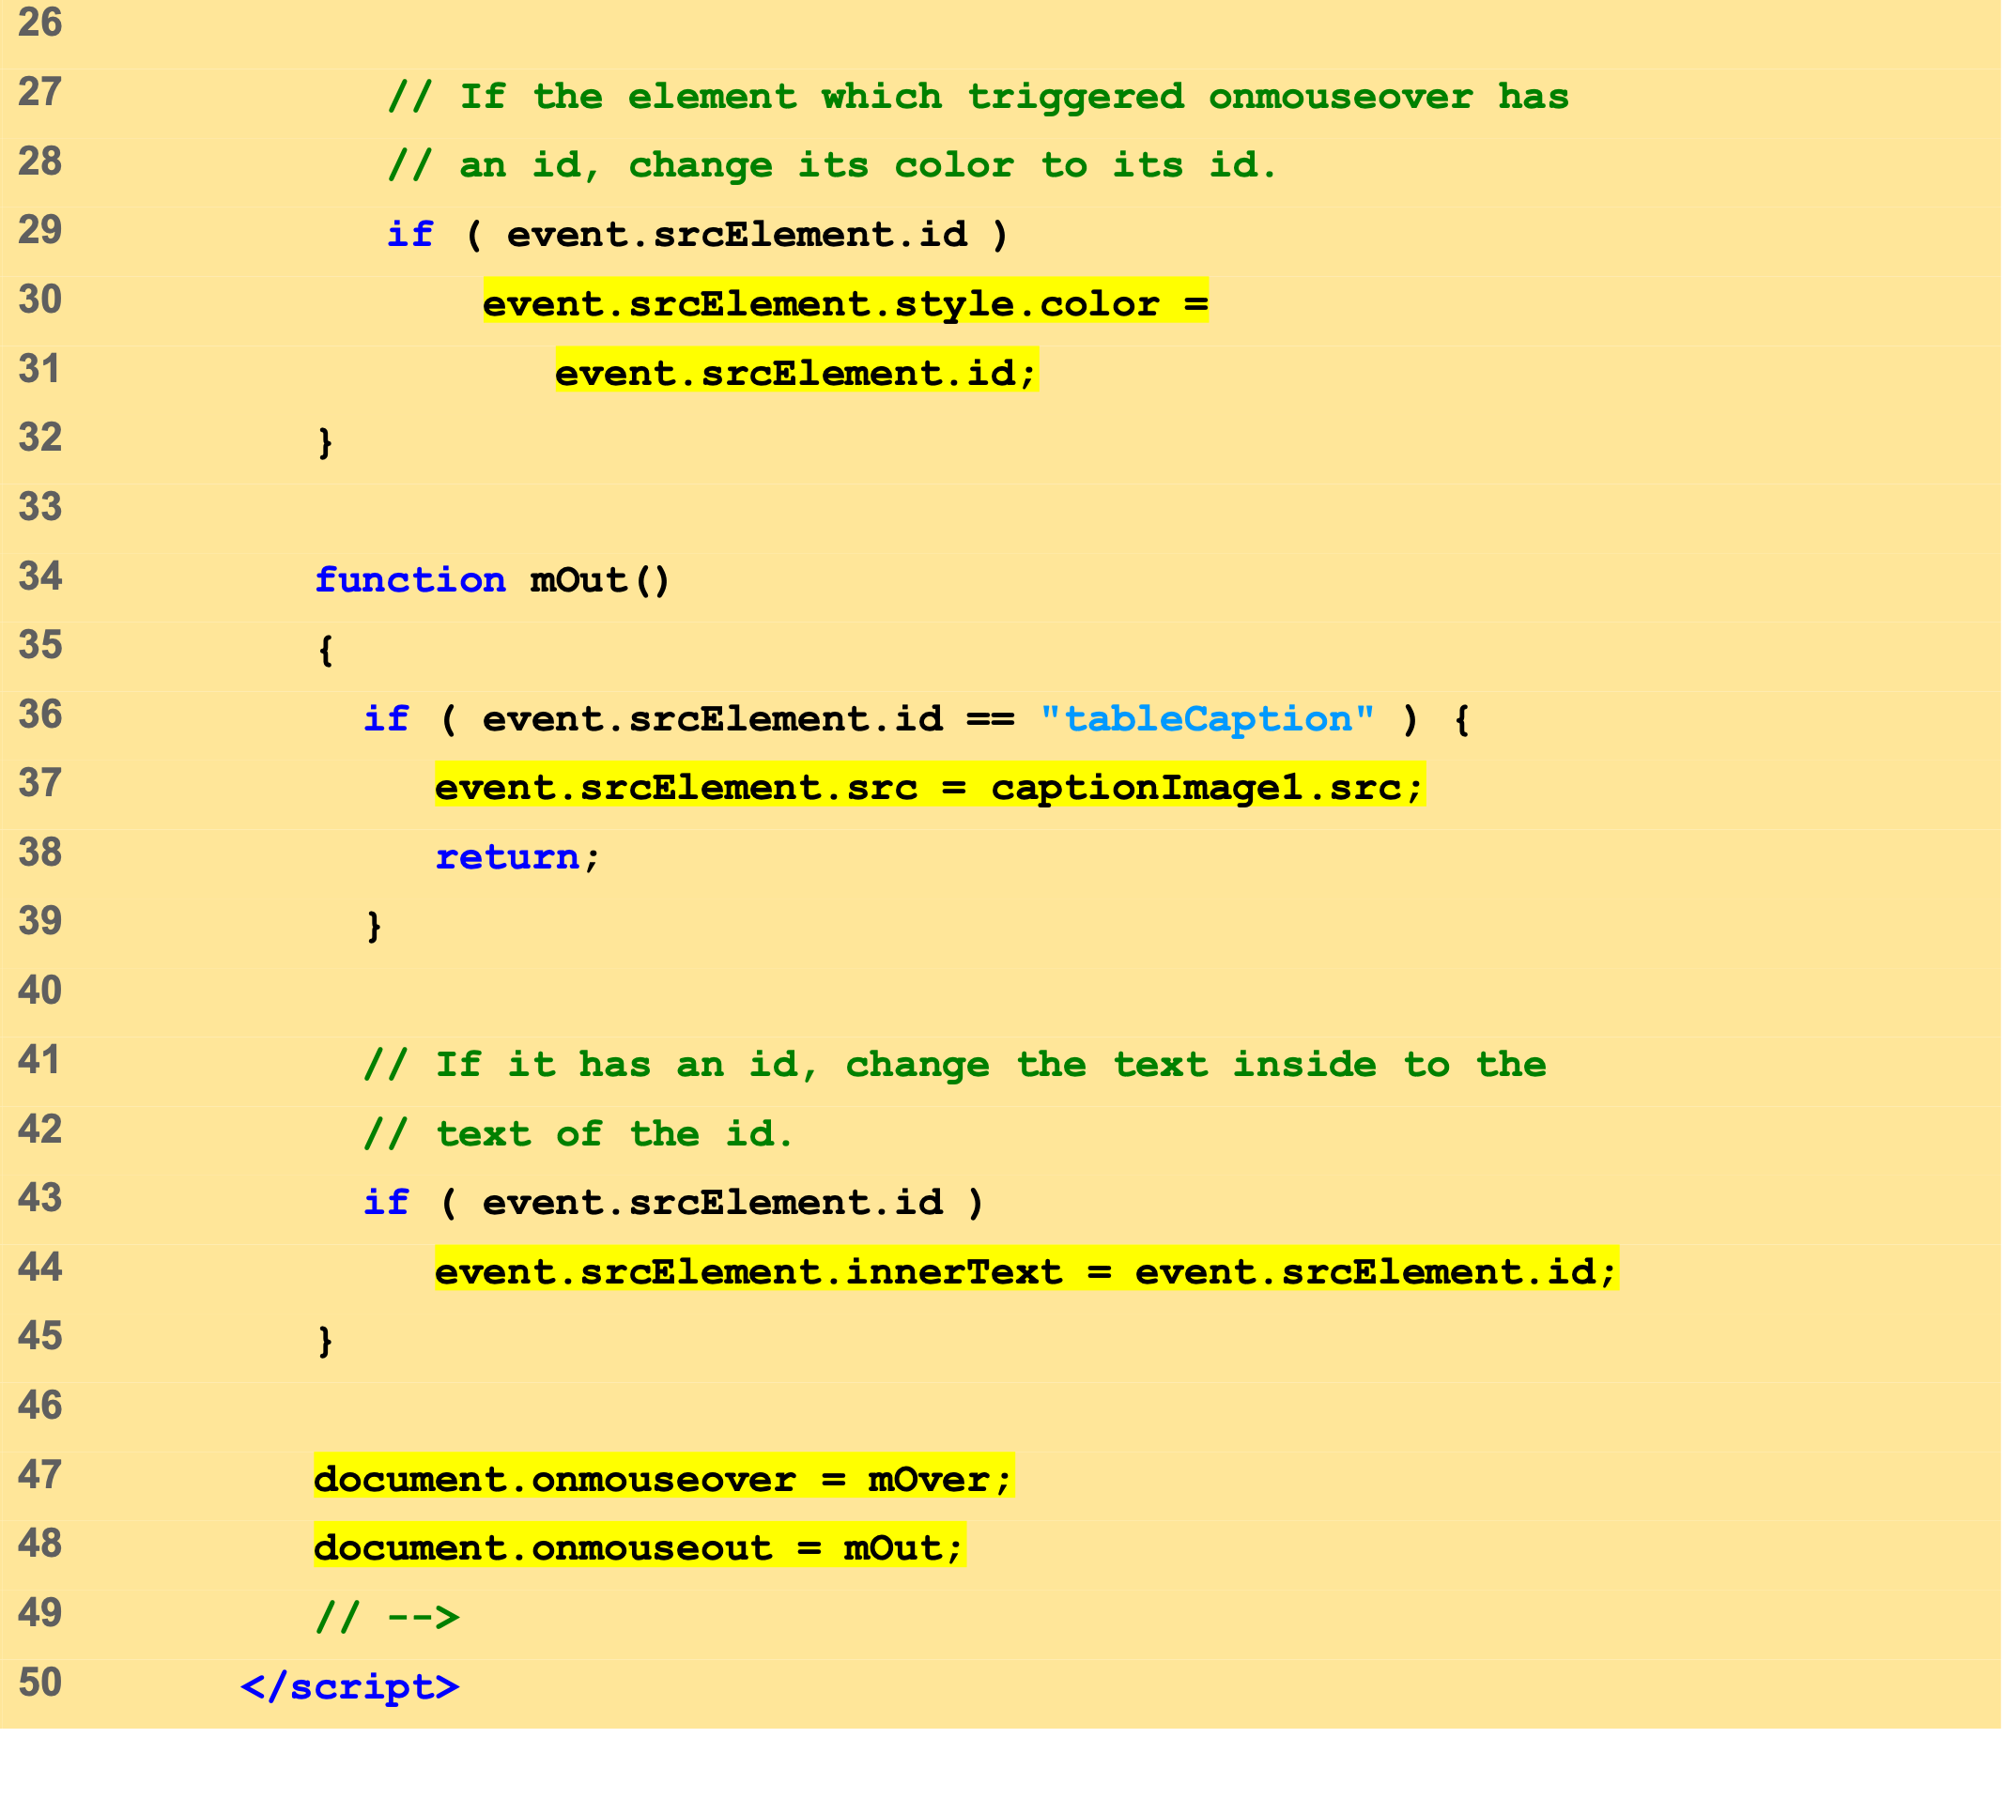
onmouseoverout .html (2 of 4)

Slide 21
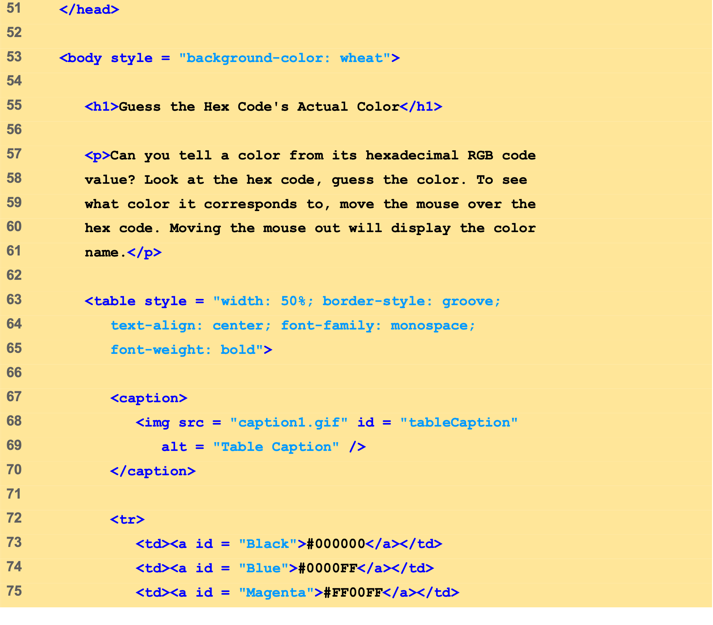
onmouseoverout .html (3 of 4)

Slide 22
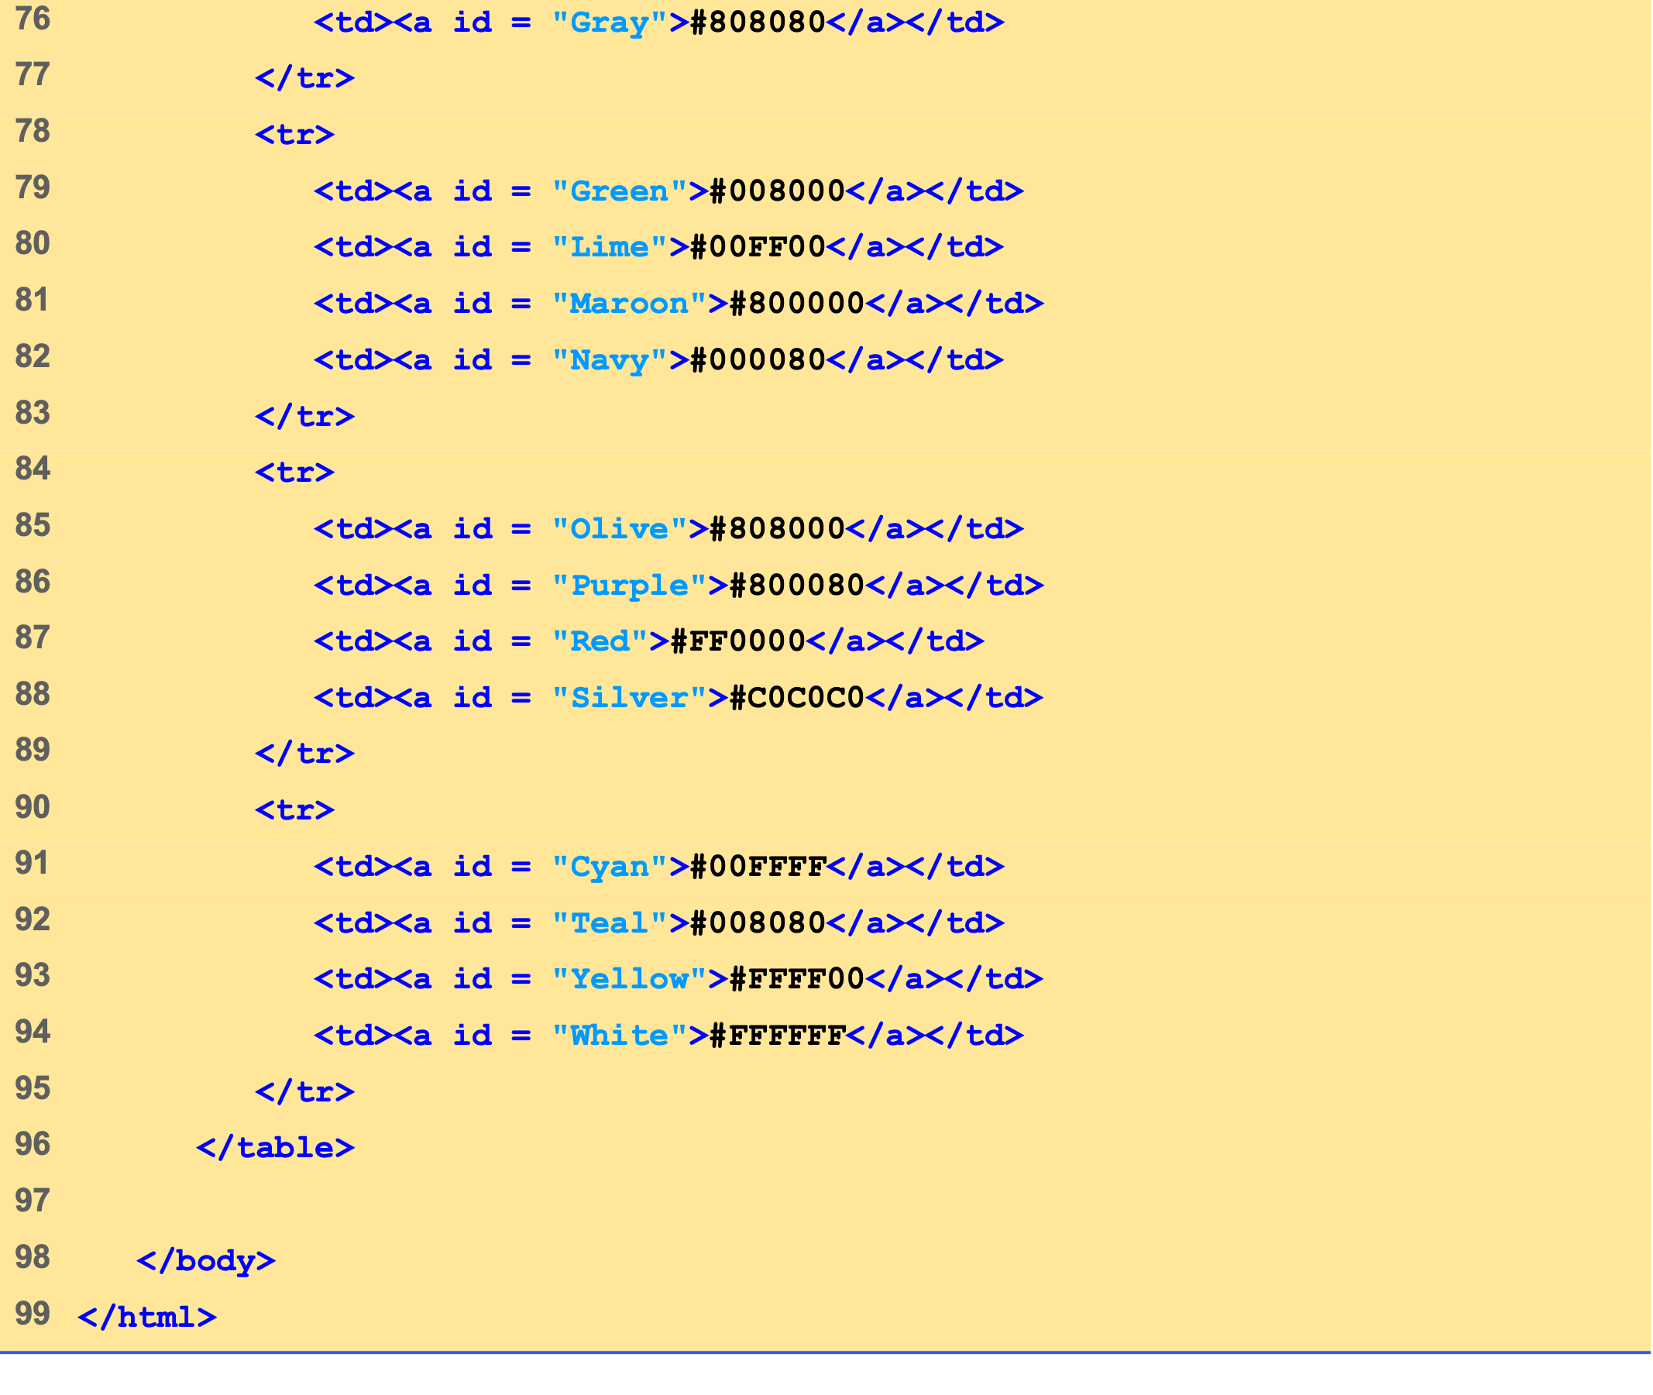
onmouseoverout .html (4 of 4)

Slide 23
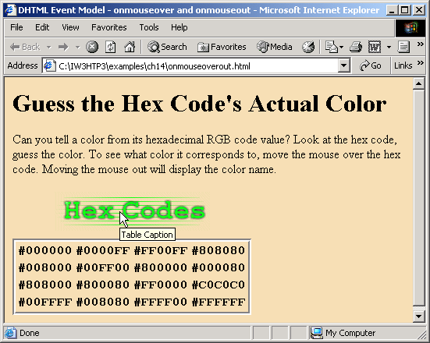
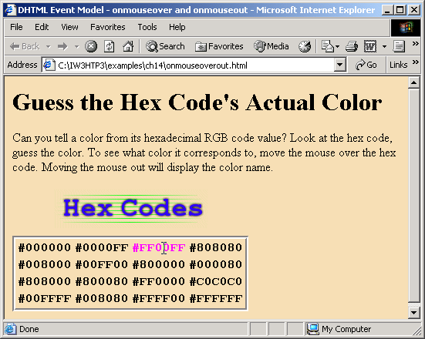
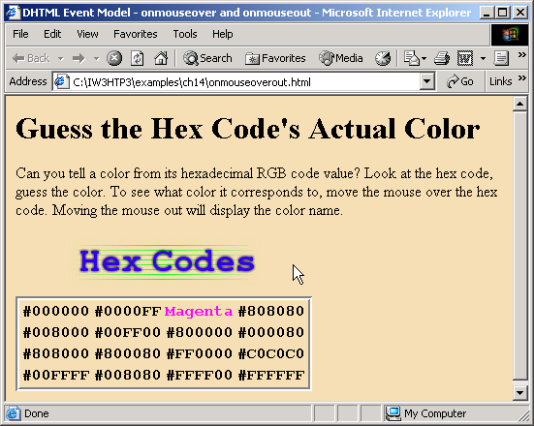

Slide 24
7 Form Processing with onfocus and onblur
onfocus event fires when element gains focus
onblur event fires when element loses focus

Slide 25
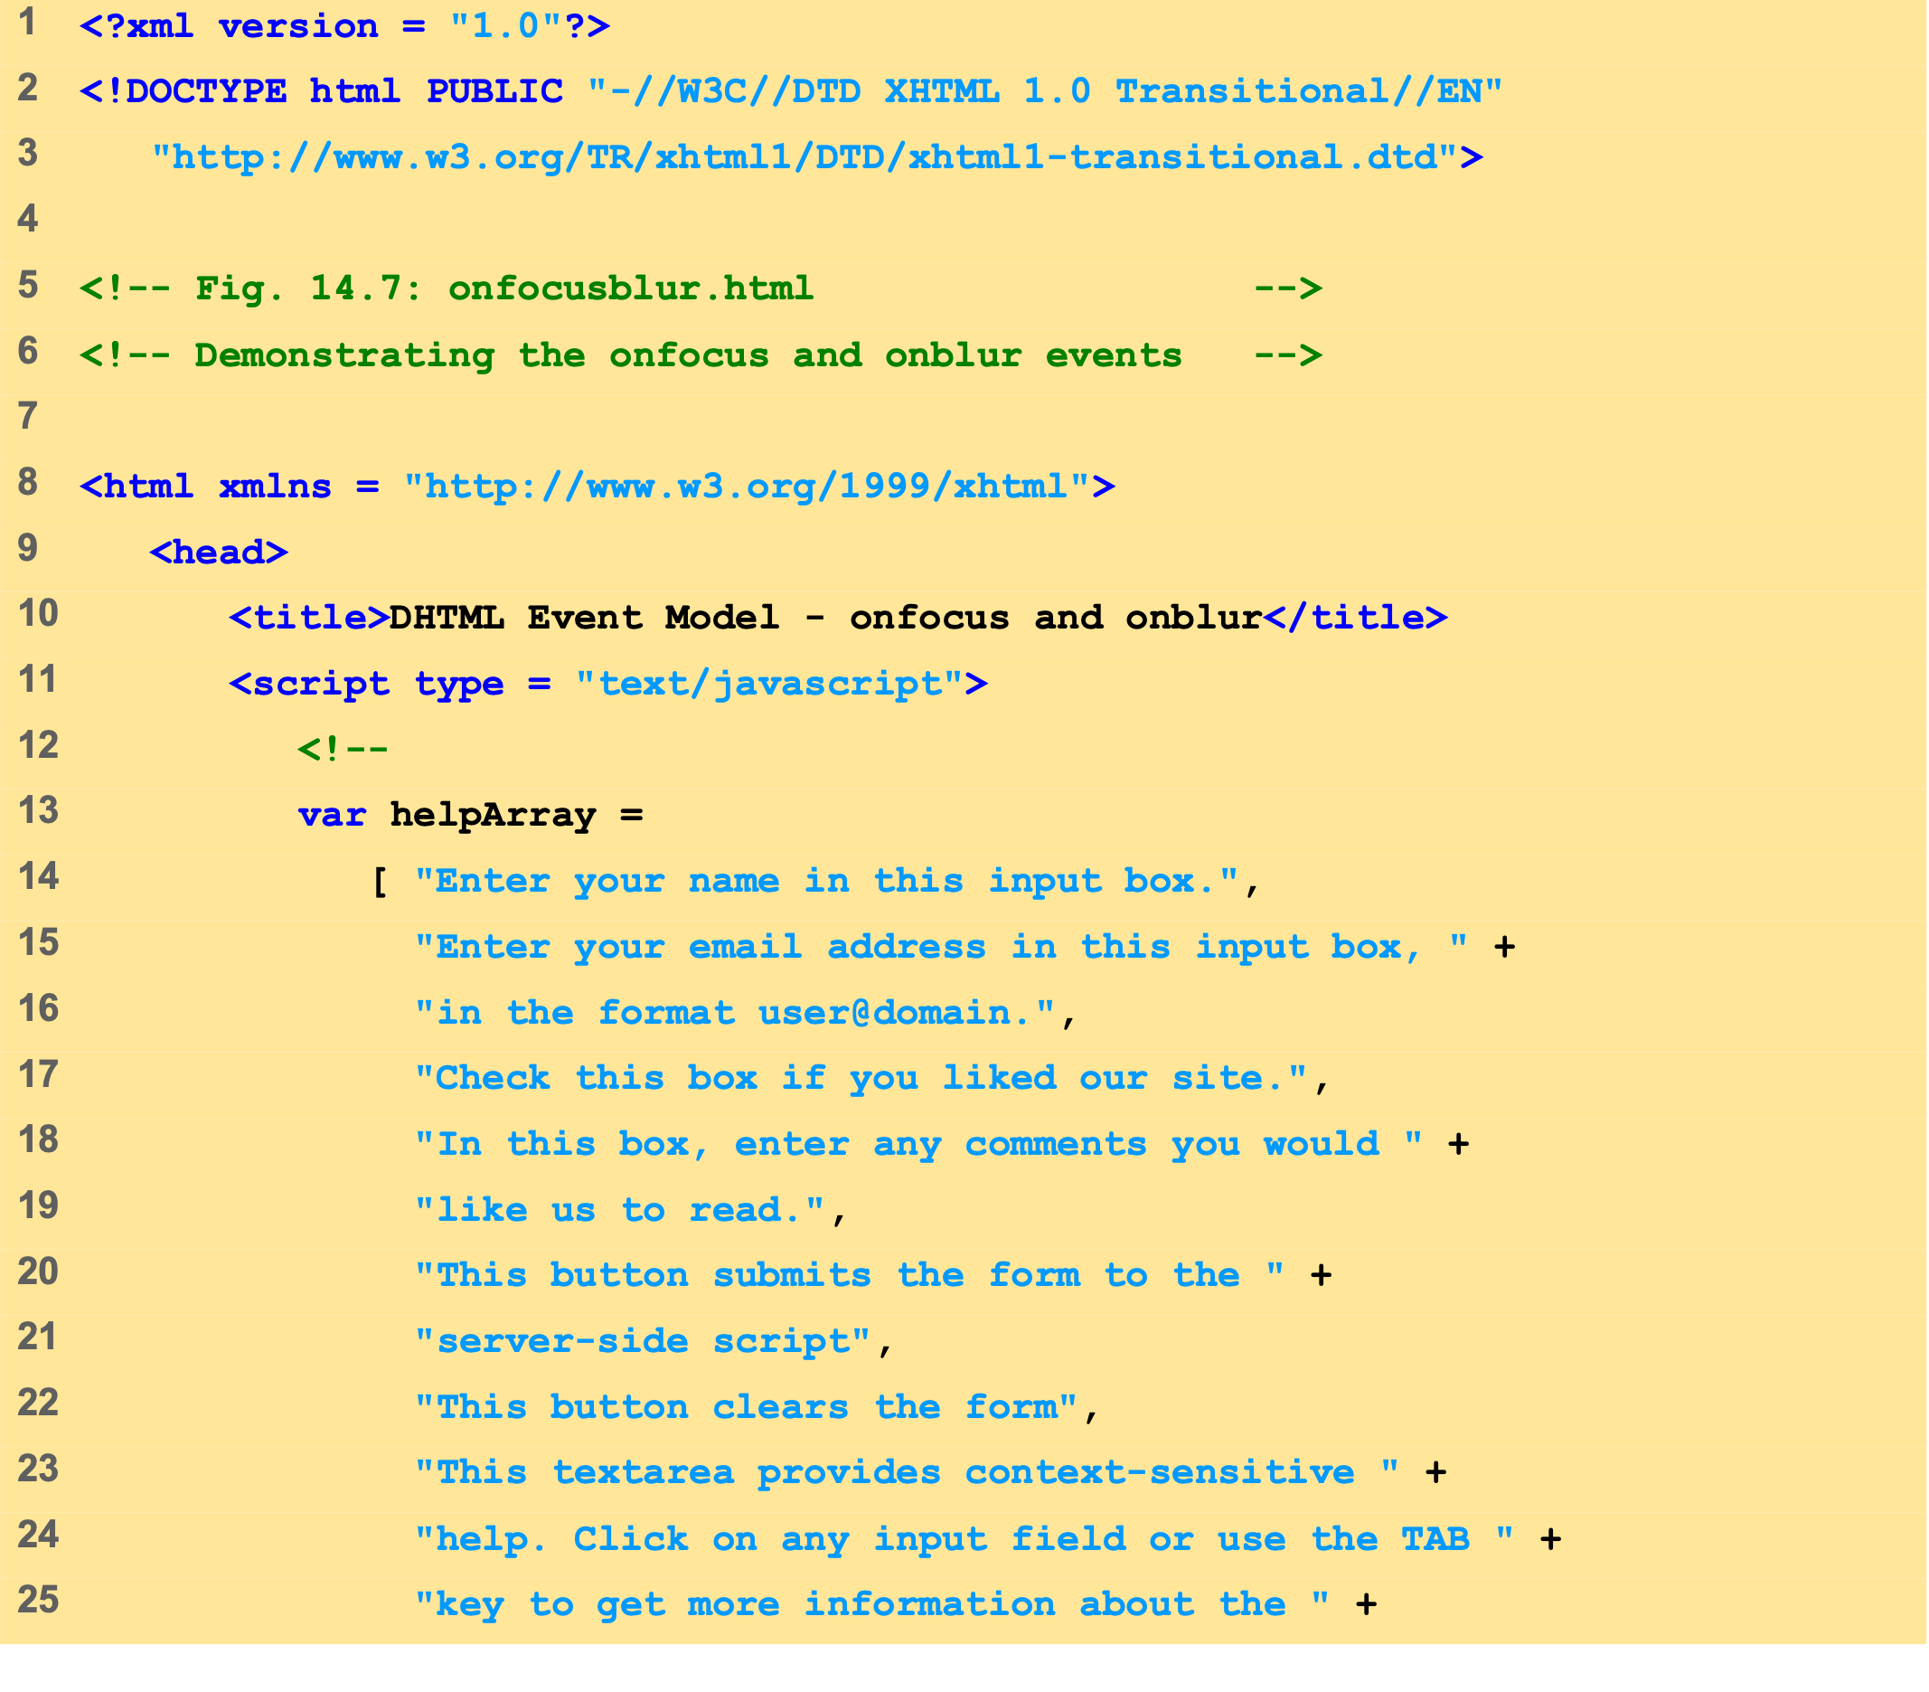
onfocusblur.html (1 of 3)

Slide 26
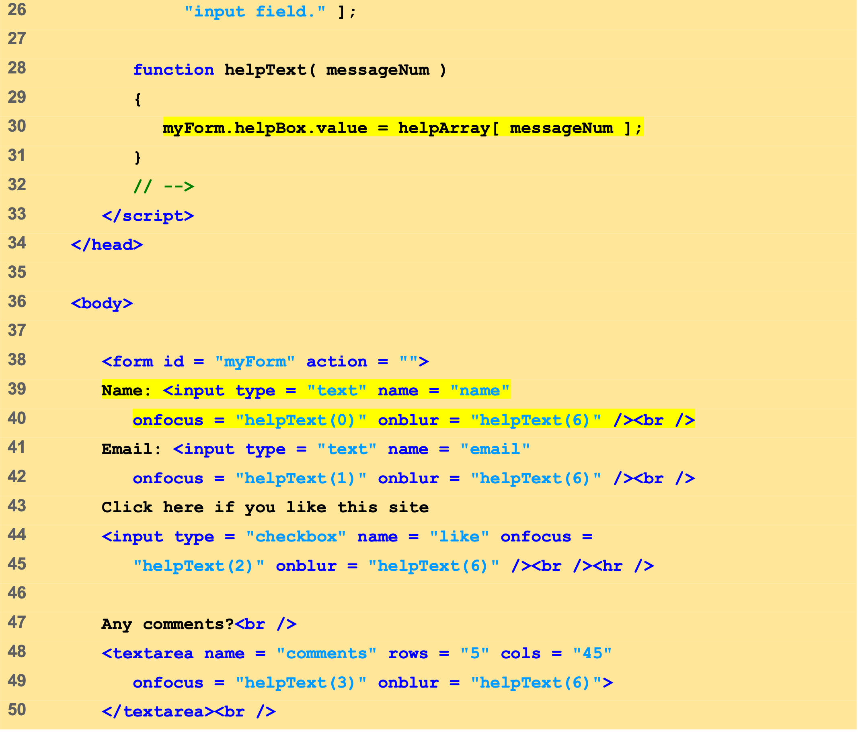
onfocusblur.html (2 of 3)

Slide 27
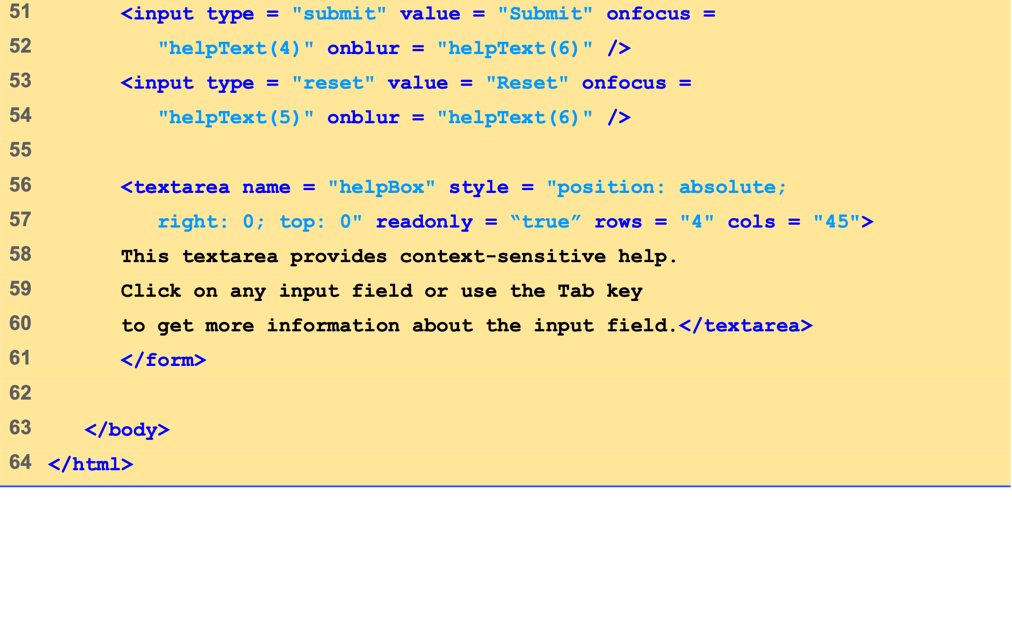
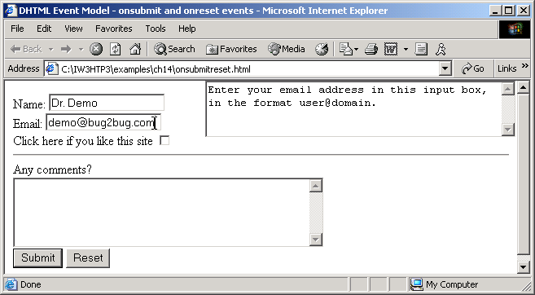
onfocusblur.html (3 of 3)

Slide 28
8 More Form Processing with onsubmit and onreset
onsubmit and onreset are useful events for processing forms

Slide 29
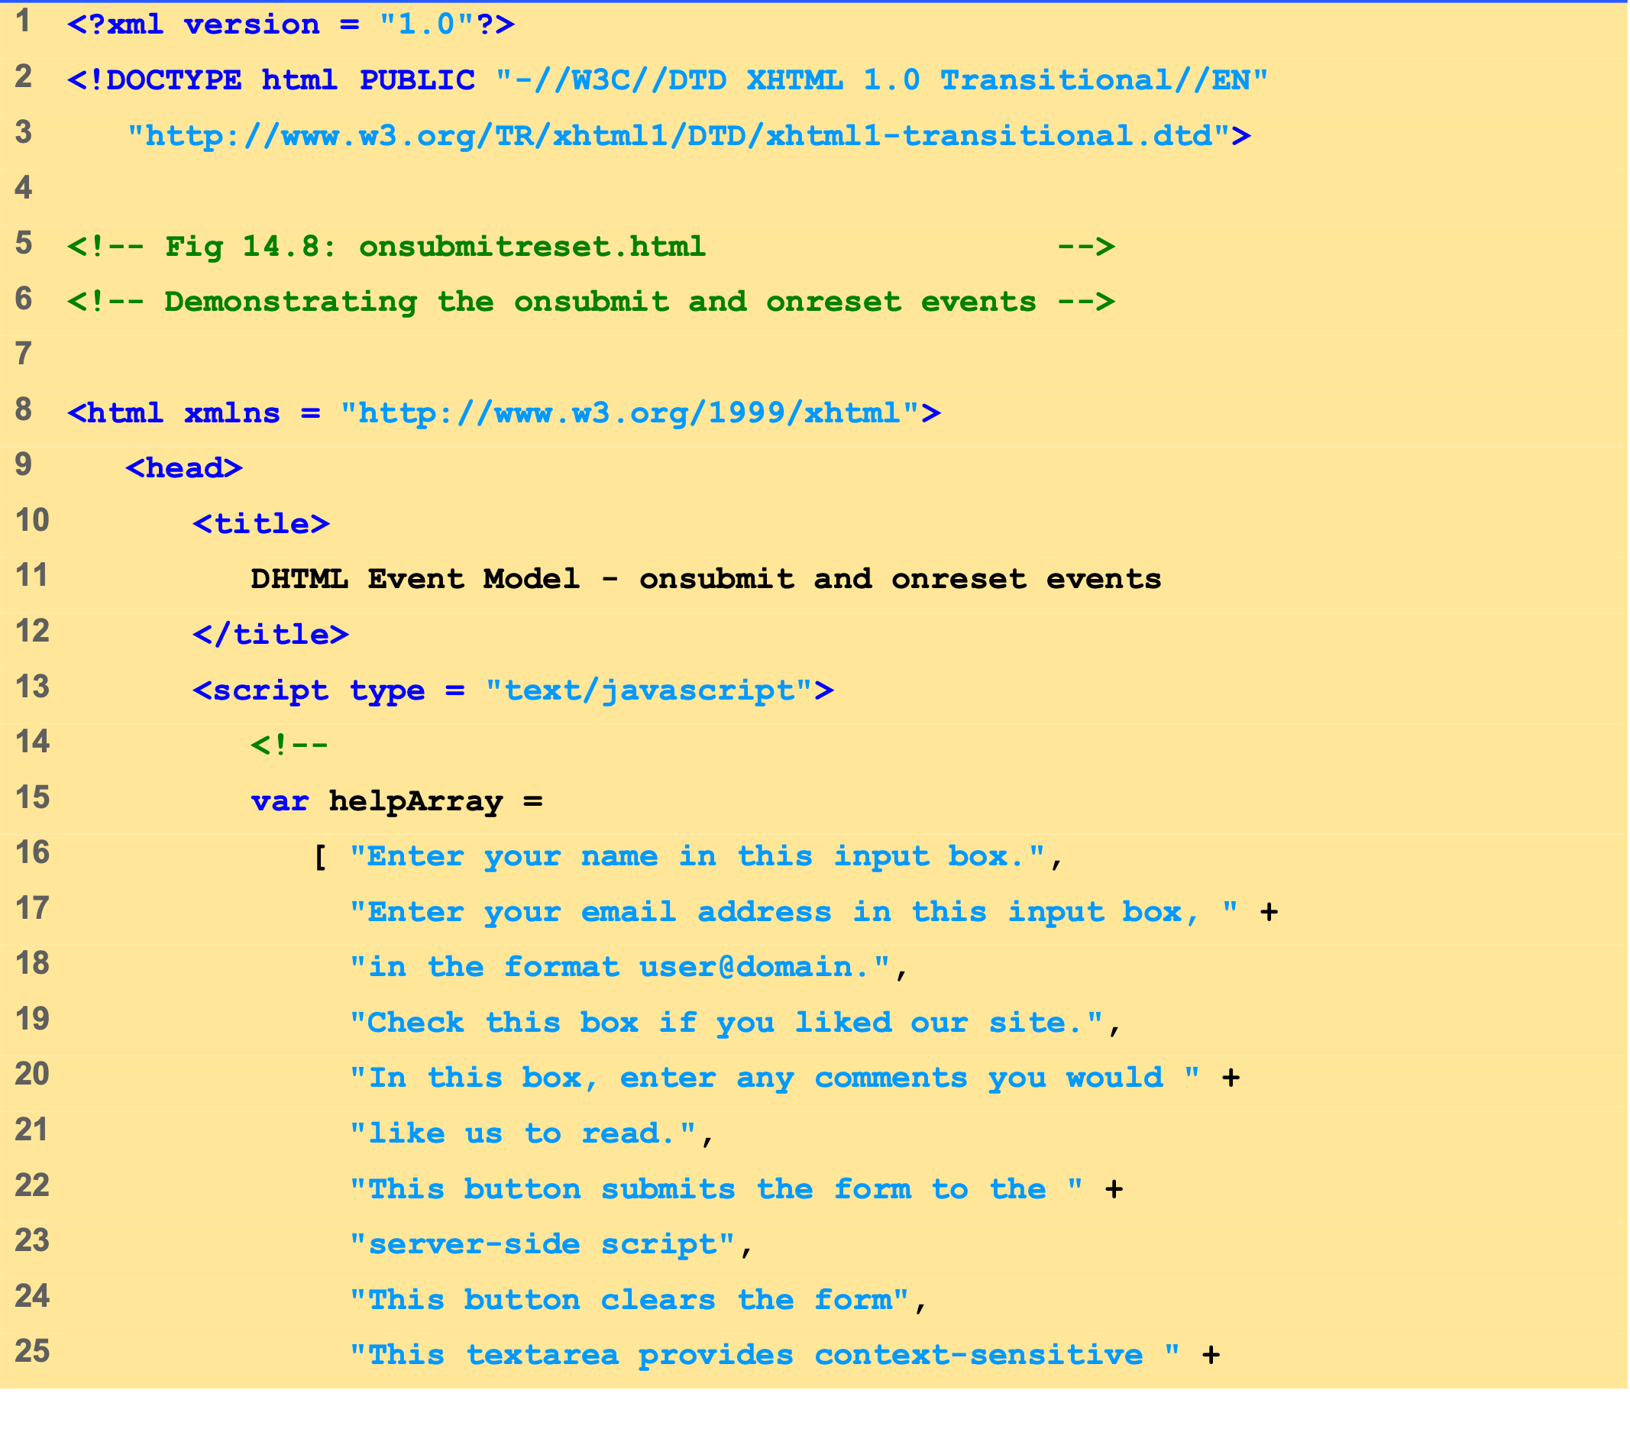
onsubmitreset.html (1 of 4)

Slide 30
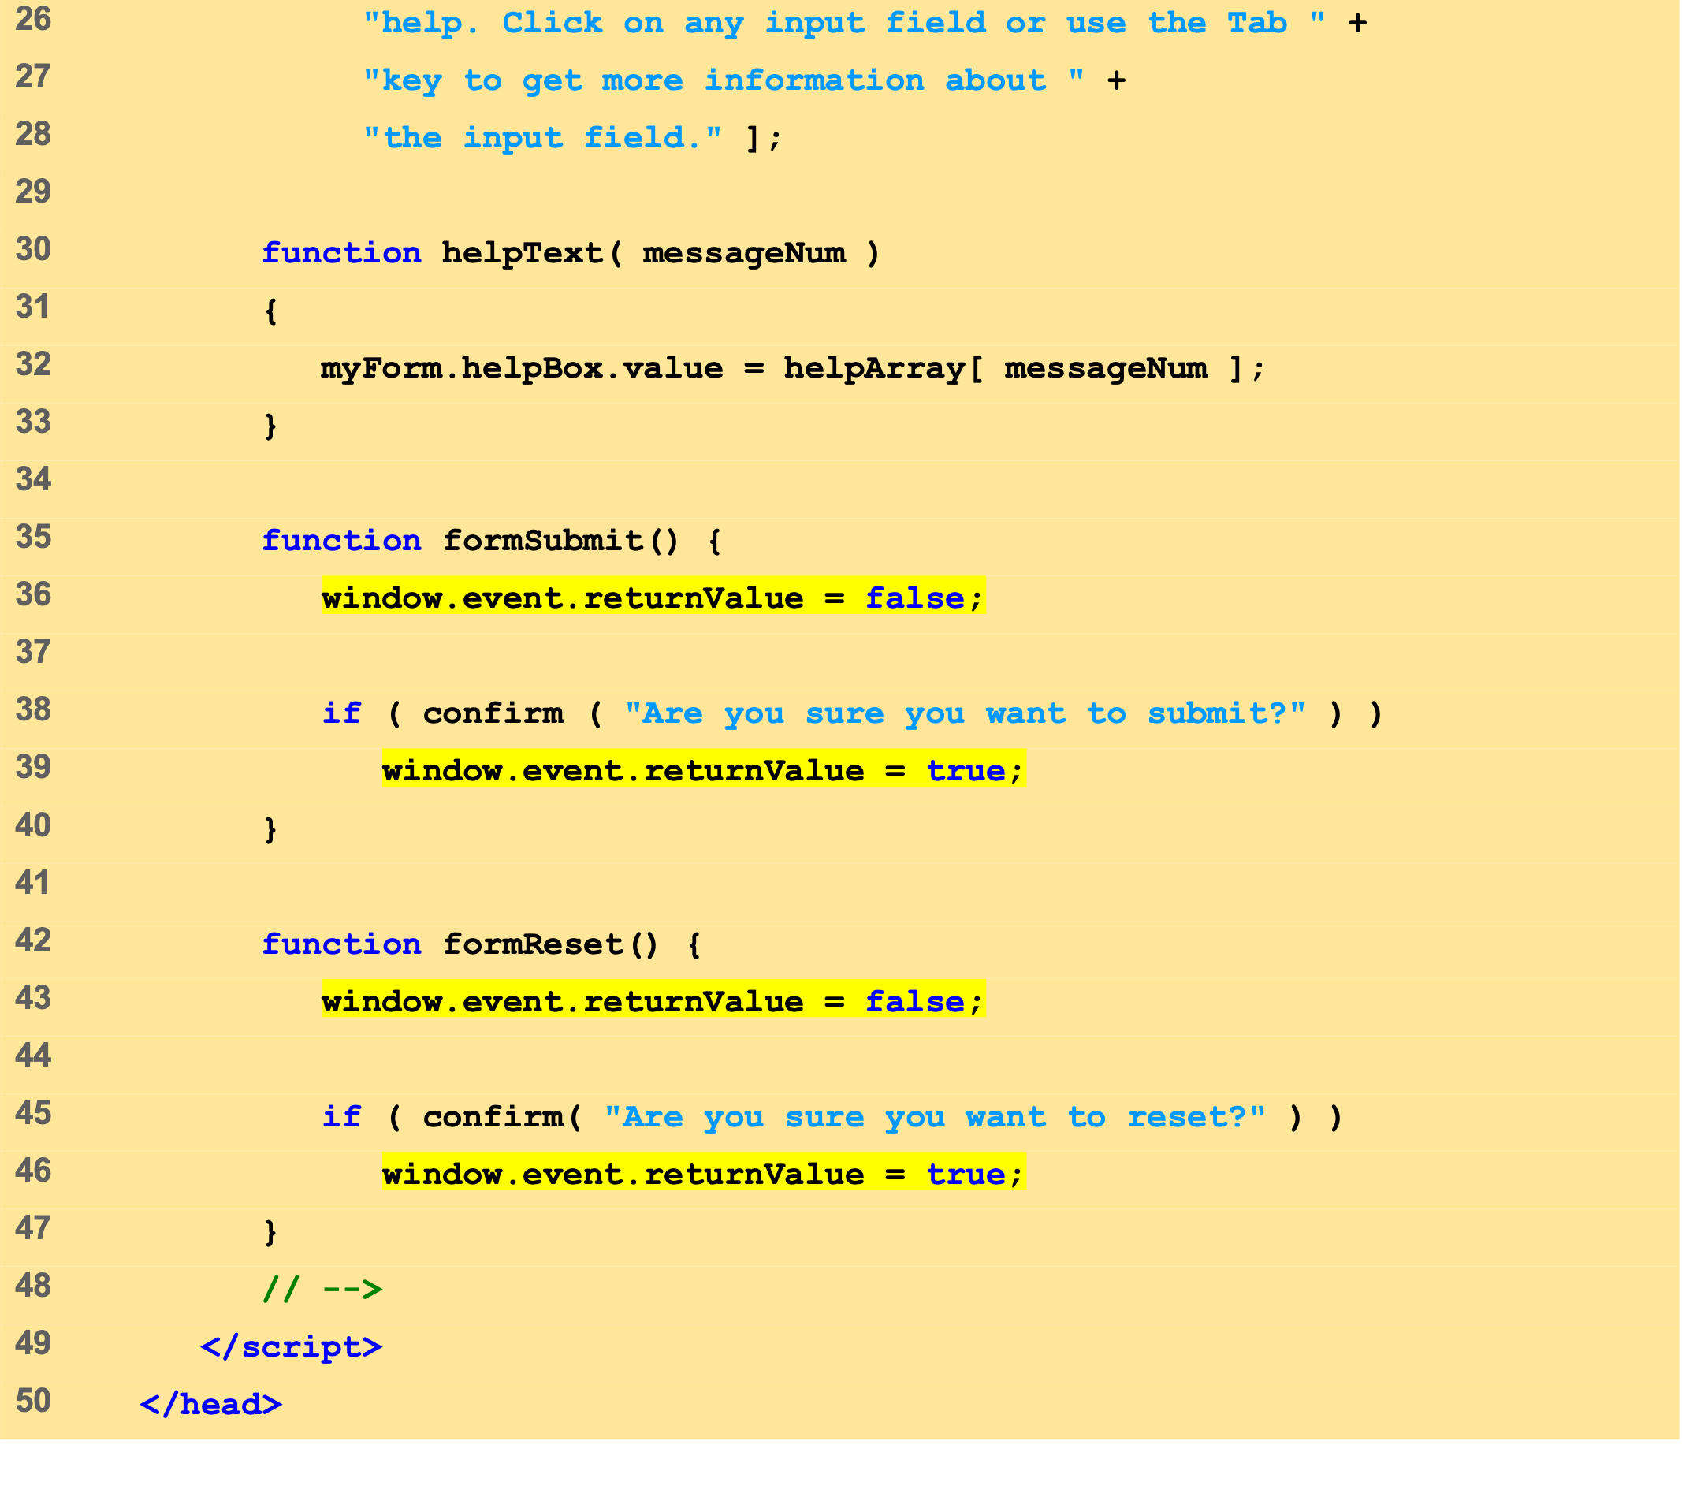
onsubmitreset.html (2 of 4)

Slide 31
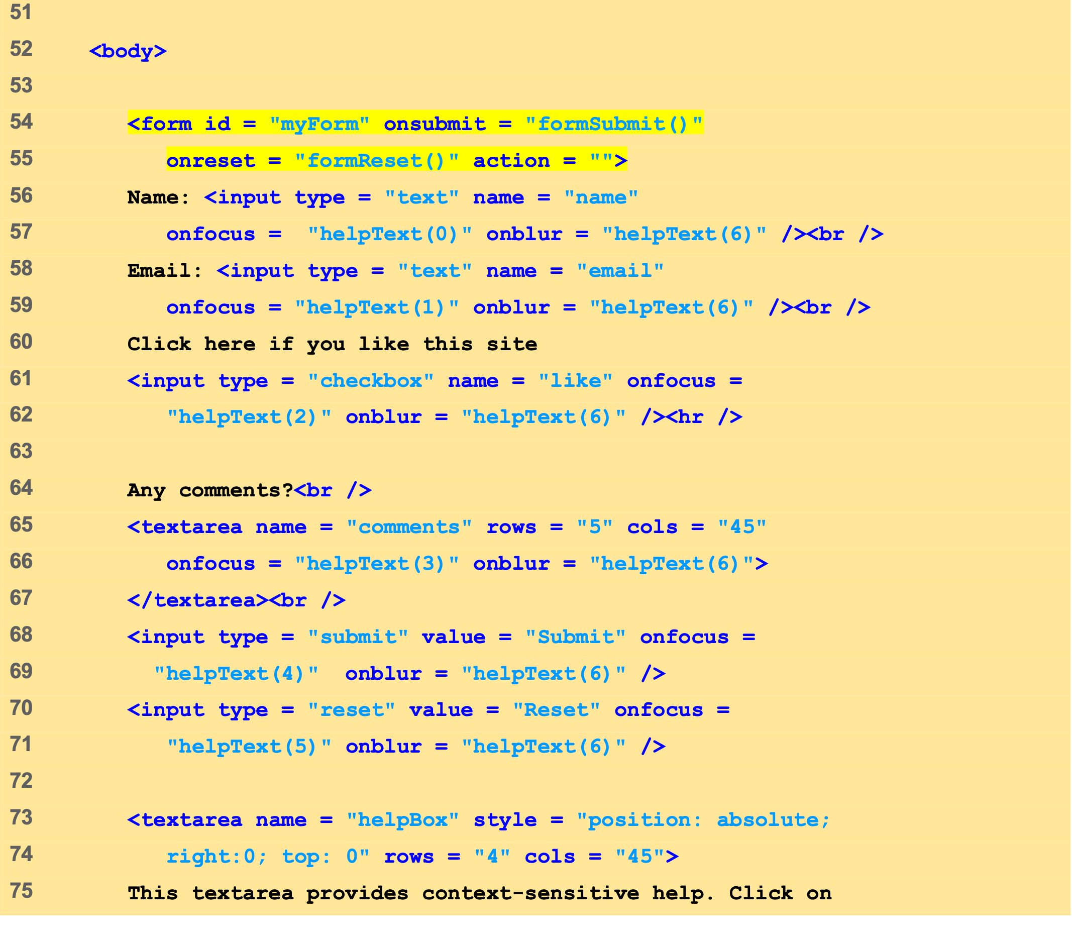
onsubmitreset.html (3 of 4)

Slide 32
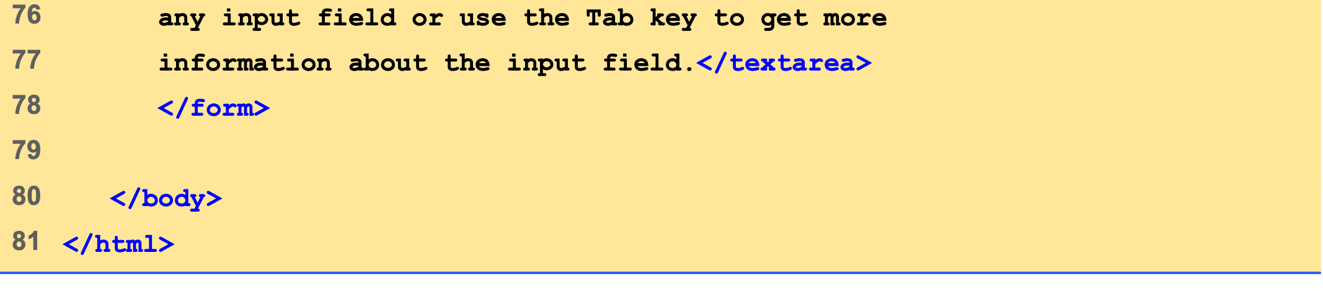
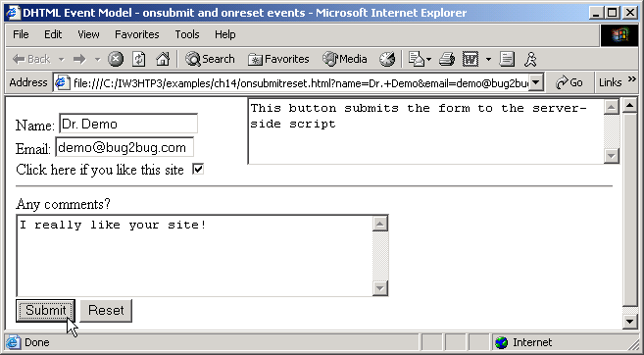
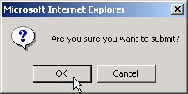
onsubmitreset.html (4 of 4)

Slide 33
9 Event Bubbling
Crucial part of the event model
Process whereby events fired in child elements “bubble” up to their parent elements

Slide 34
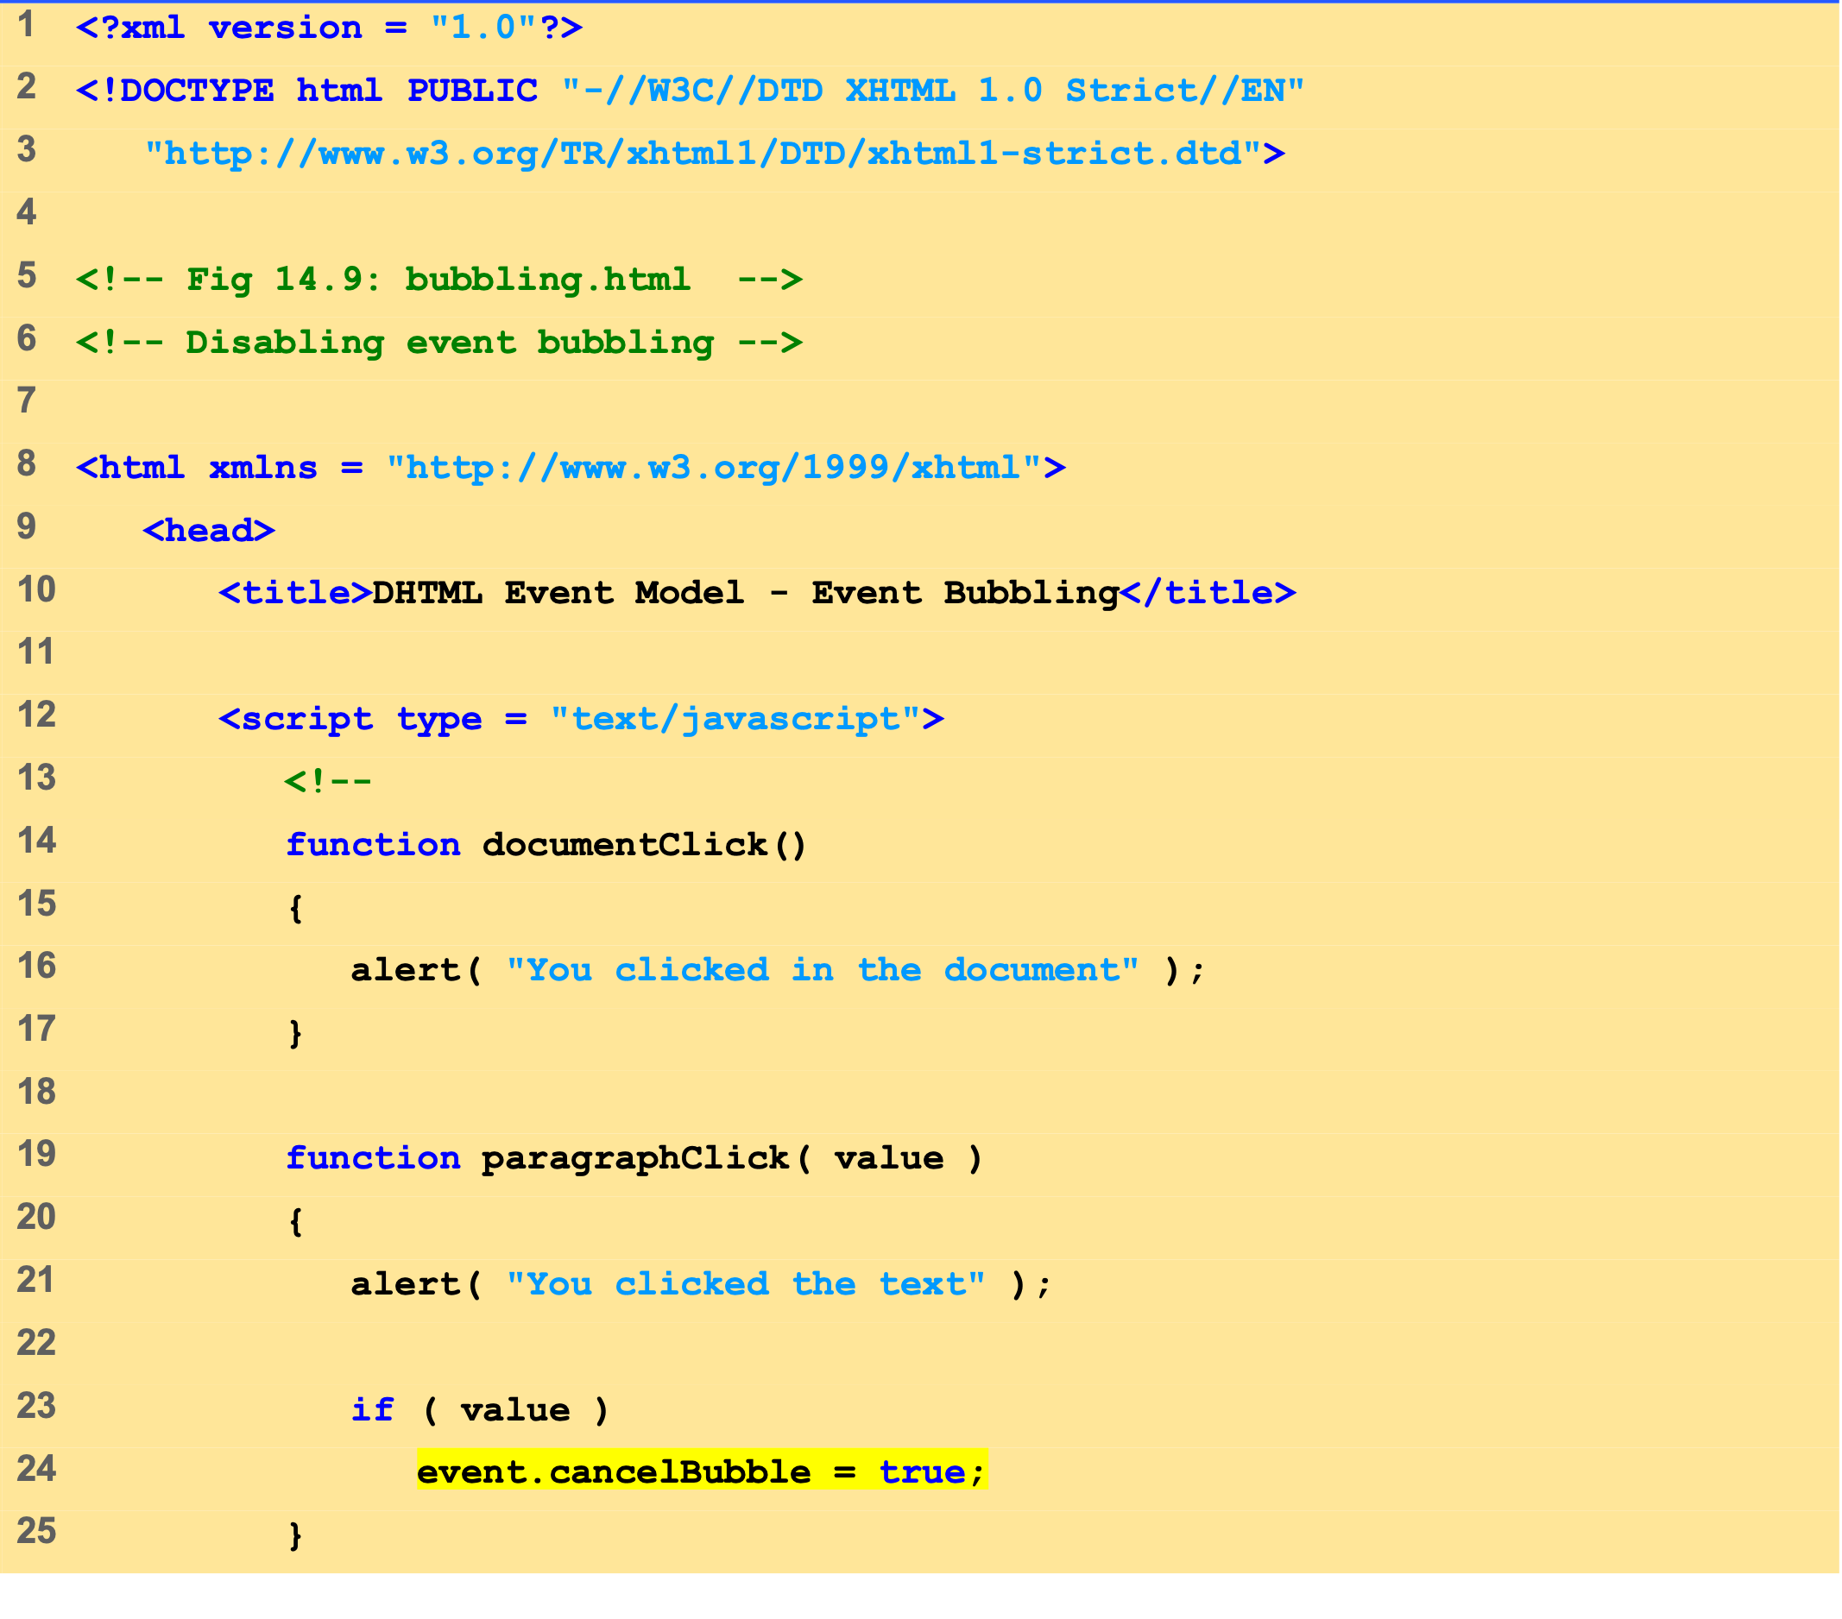
bubbling.html (1 of 2)

Slide 35
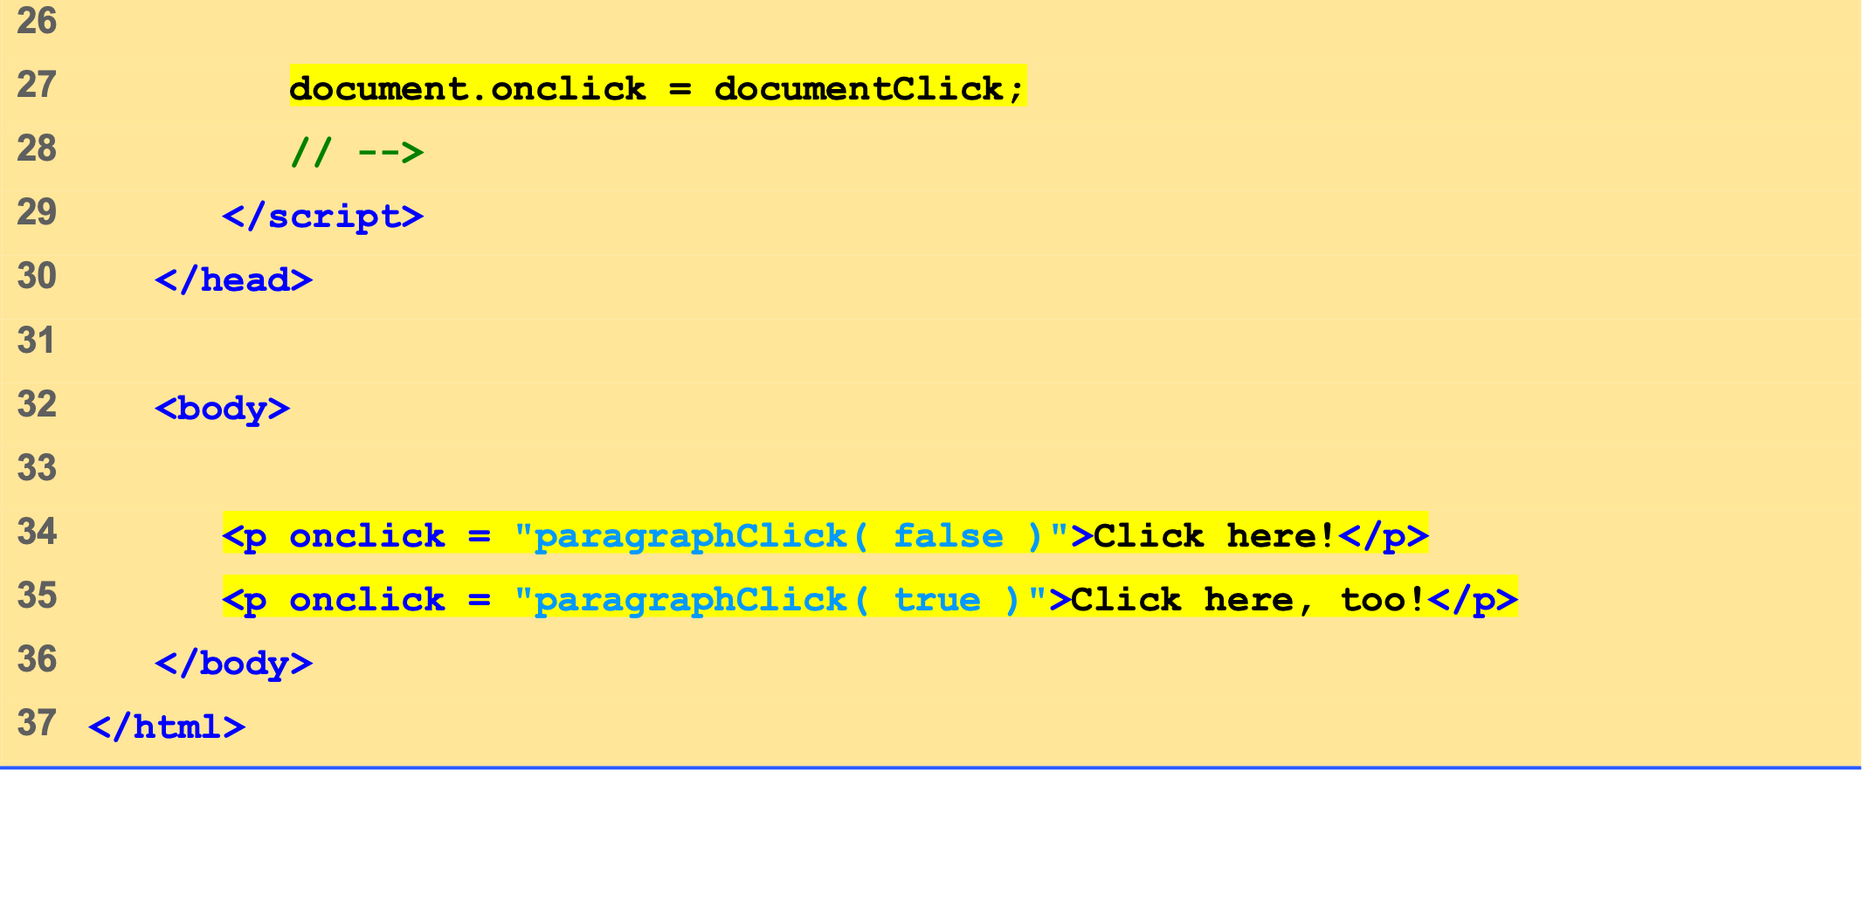
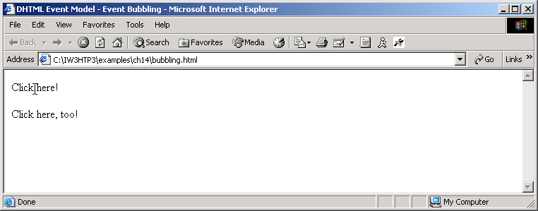
bubbling.html (2 of 2)

Slide 36
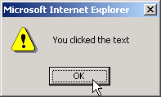
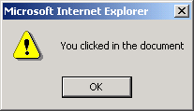

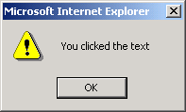

Slide 37
10 More DHTML Events
Remaining DHTML events and their descriptions

Slide 38
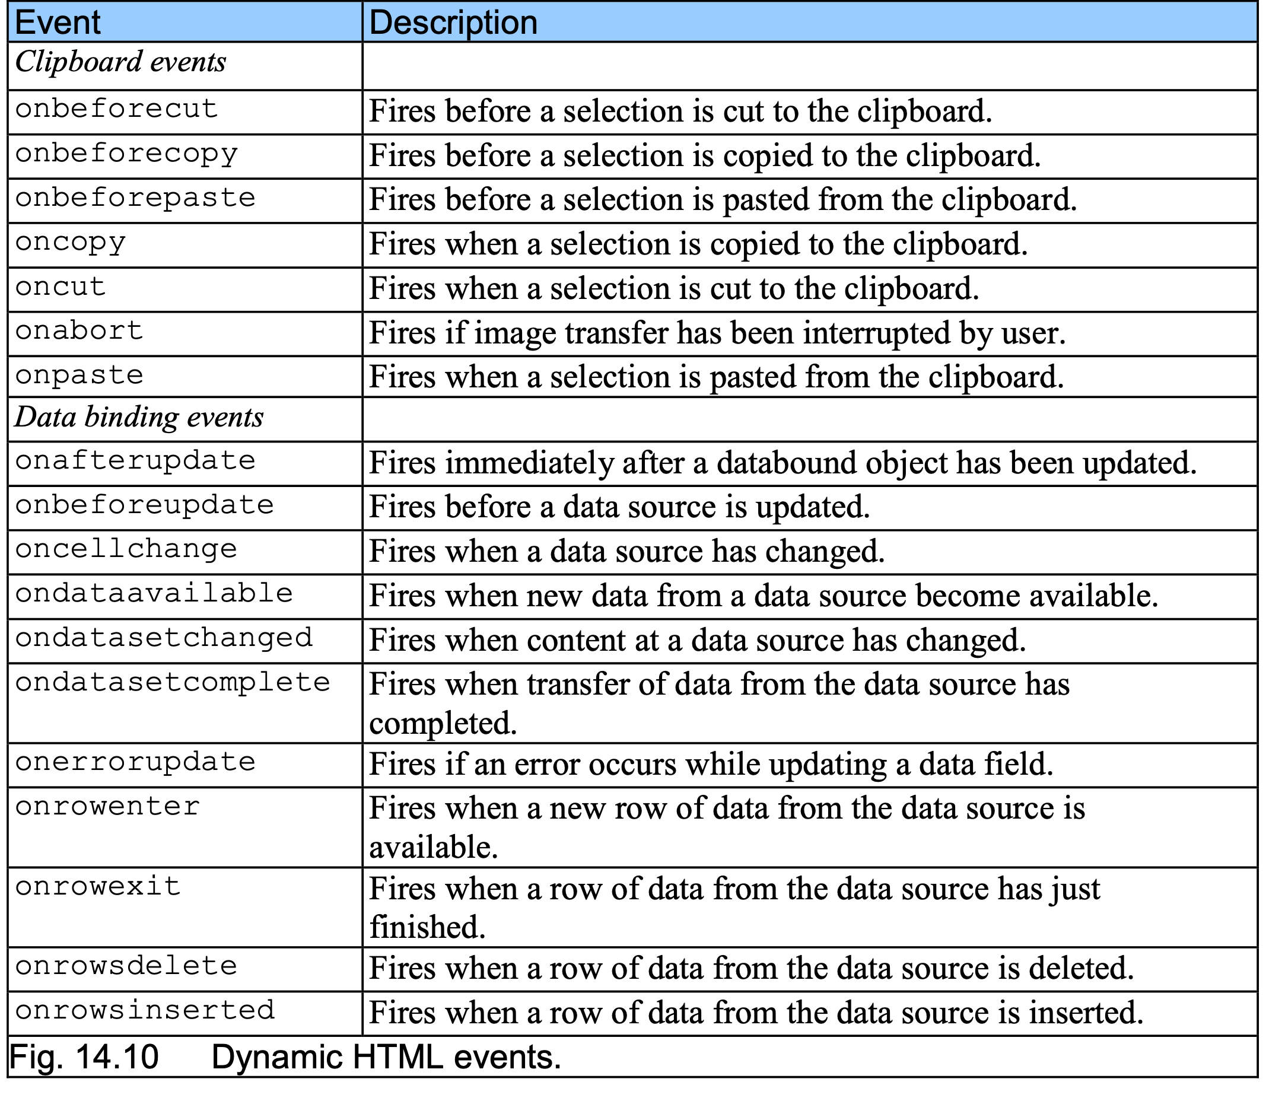
10 More DHTML Events

Slide 39
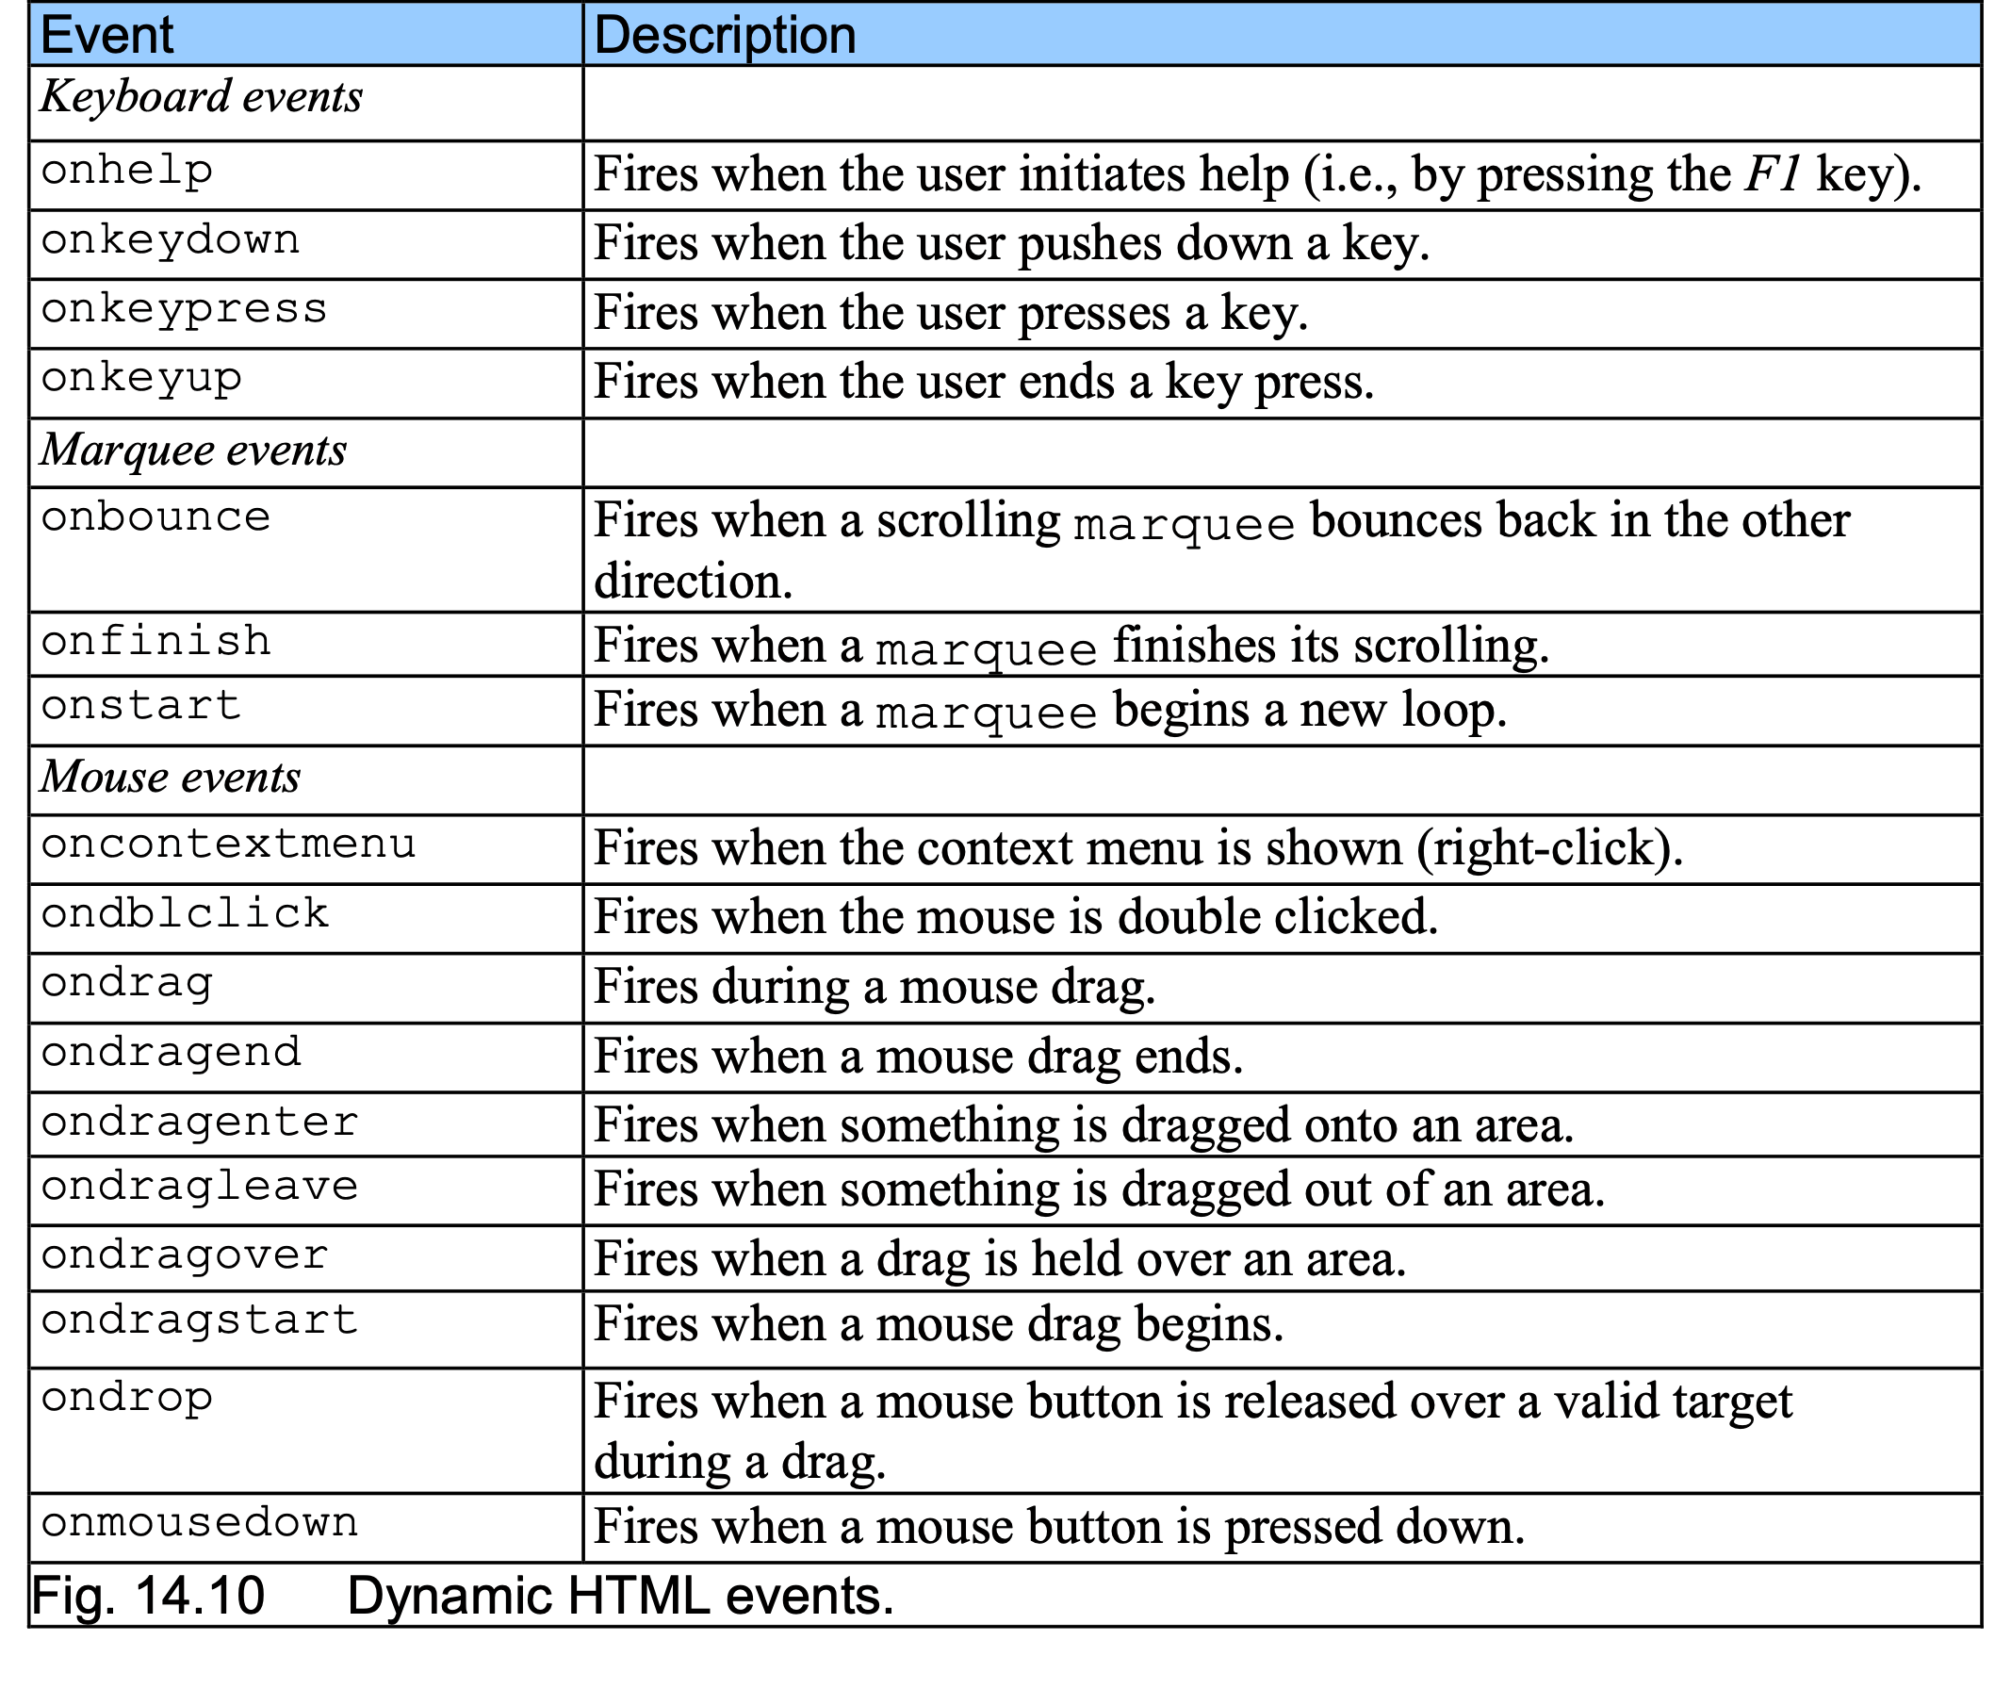
10 More DHTML Events

Slide 40
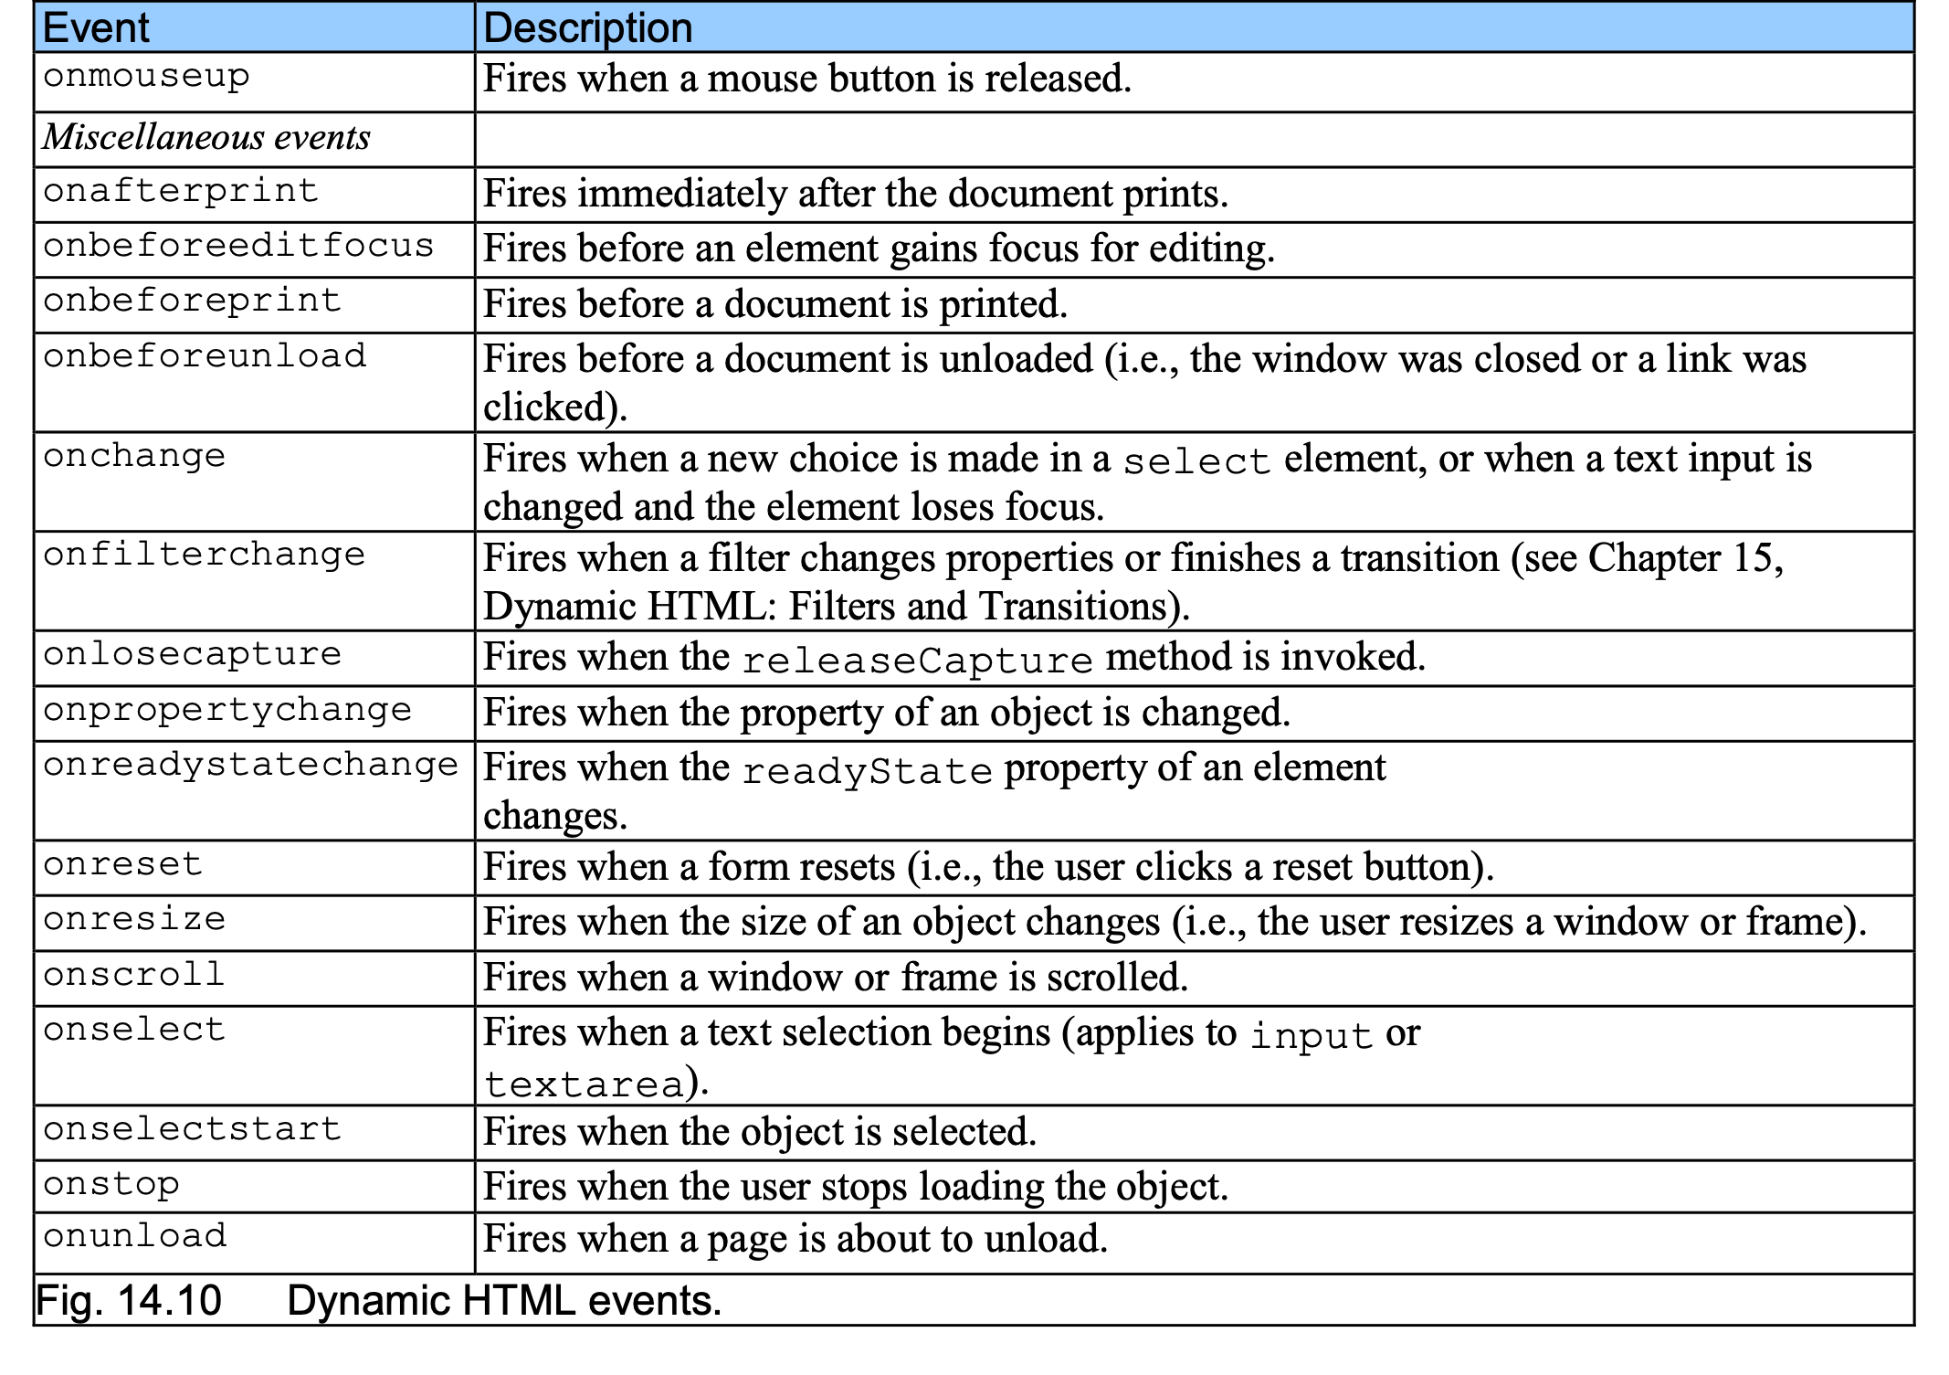
10 More DHTML Events

Slide 41
Web Resources
www.javascriptmall.com
developer.netscape.com/tech/javascript
www.mozilla.org/js/language
Deitel and deitel, Internet and World Wide Web How to Program: Third Edition

